Slide 1


Game Theory
Part II) Static Games Of Complete Information
6- Mixed Strategies
Dr. Vahid Haghighatdoost
haghighatdoost@shahed.ac.ir
http://ref.shahed.ac.ir/haghighatdoost
Engineering Department

Slide 2
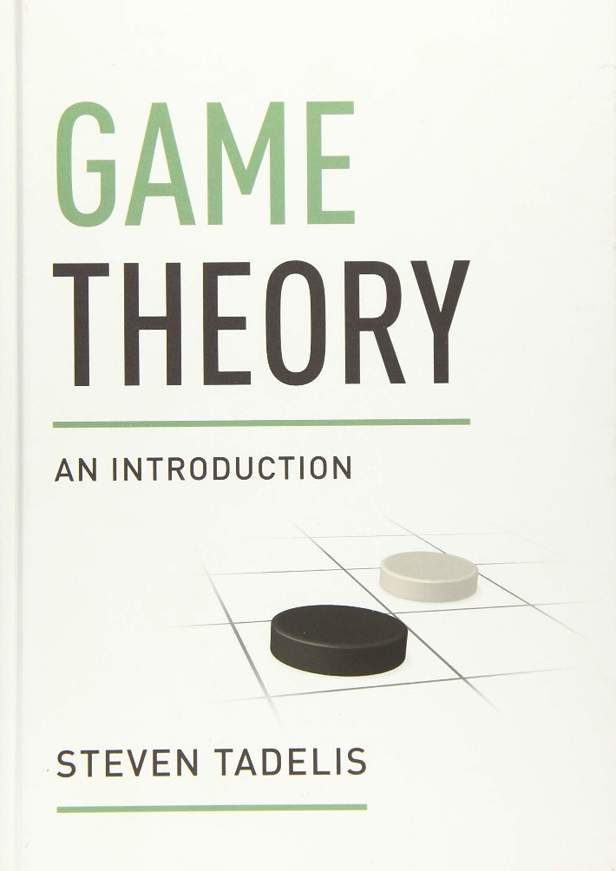
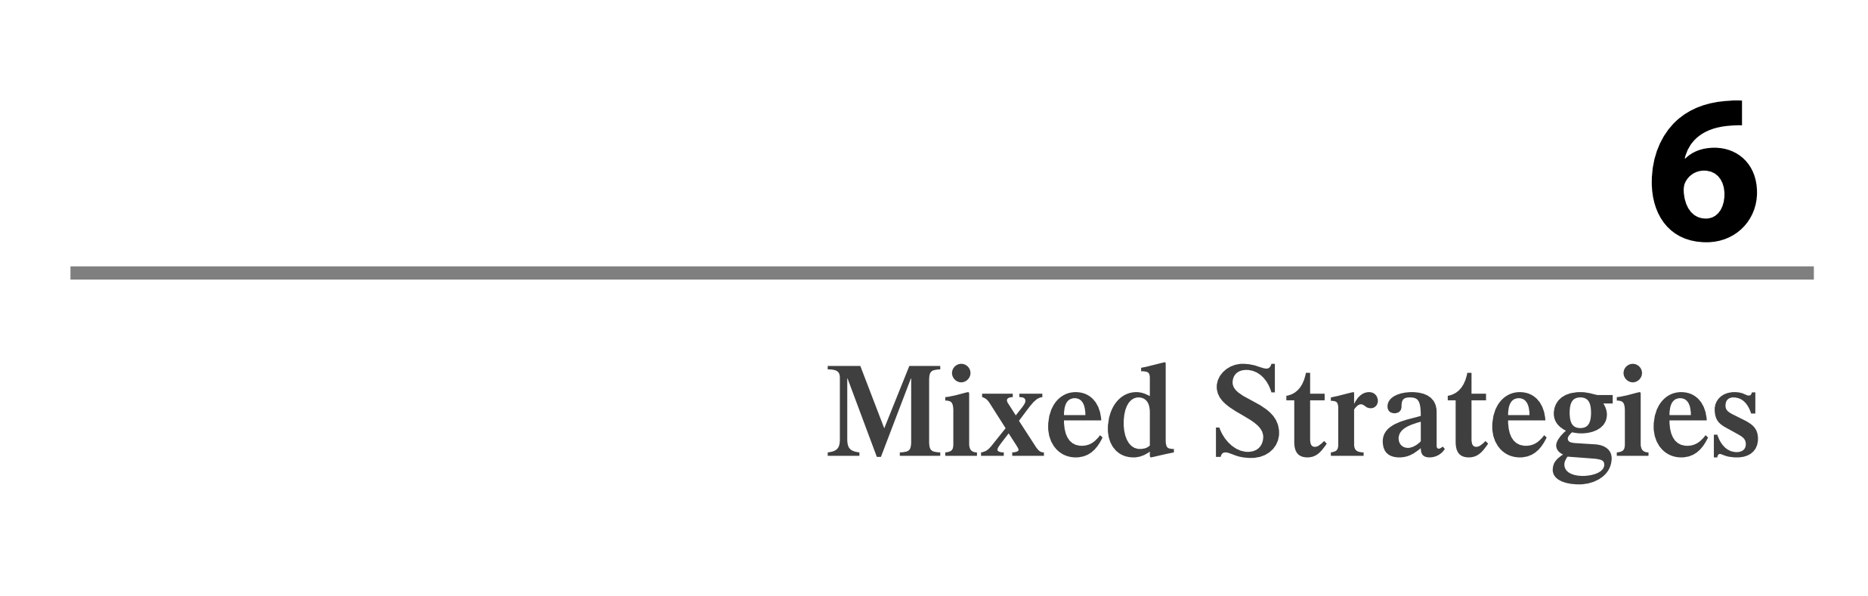
منابع درسی
Tadelis, Steven. Game theory: an introduction. Princeton university press, 2013.

Slide 3
مقدمه
در فصل‌های قبلی، بازیکنان را به استفاده از استراتژی‌های خالص (pure strategy) محدود کردیم و بحث در مورد گزینه‌ای را که یک بازیکن ممکن است برای انتخاب تصادفی بین چندین استراتژی خالص خود انتخاب کند، به آینده موکول کردیم.
در واقع، همانطور که اکنون خواهیم دید، بازی های زیادی وجود دارد که اگر توانایی بازیکنان را در انتخاب استراتژی های تصادفی در نظر نگیریم، هیچ پیش بینی تعادلی برای آنها وجود نخواهد داشت.

Slide 4
مقدمه- بازی تشابه سکه ها
بازی کلاسیک با جمع صفر به نام Matching Pennies را در نظر بگیرید.
بازیکنان 1 و 2 هر کدام به طور همزمان یک سکه روی میز قرار می دهند.
اگر دو سکه از یک طرف باشند، بازیکن 1 هر دو را دریافت می کند. در غیر این صورت بازیکن 2 برنده میشود.
ما می توانیم این بازی را در ماتریس زیر نشان دهیم

Slide 5
مقدمه- بازی تشابه سکه ها
همانطور که می بینید، روشی که برای یافتن نقطه تعادل نش داشتیم، در اینجا جواب نمیدهد.
آیا این بدان معناست که تعادل نش وجود ندارد؟
به زودی خواهیم دید که اگر به بازیکنان اجازه دهیم استراتژی‌های تصادفی را انتخاب کنند، واقعاً تعادل نش وجود خواهد داشت و تعادل پیشنهادی جذابیت شهودی خواهد داشت.

Slide 6
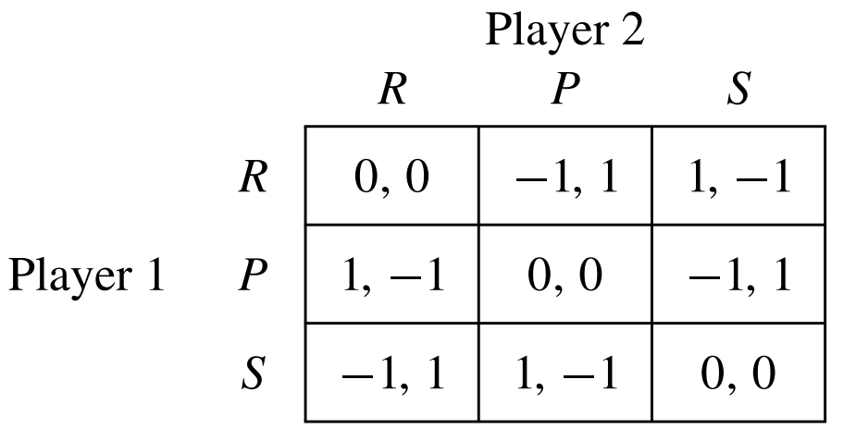
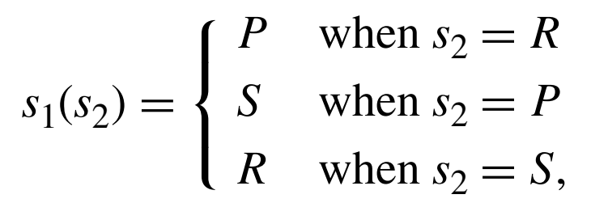
مقدمه- بازی سنگ کاغذ قیچی
تشابه سکه ها، تنها بازی ساده ای نیست که نمی تواند تعادل نش با استراتژی خالص داشته باشد.
بازی سنگ-کاغذ-قیچی نیز شرایط مشابهی را دارد

Slide 7
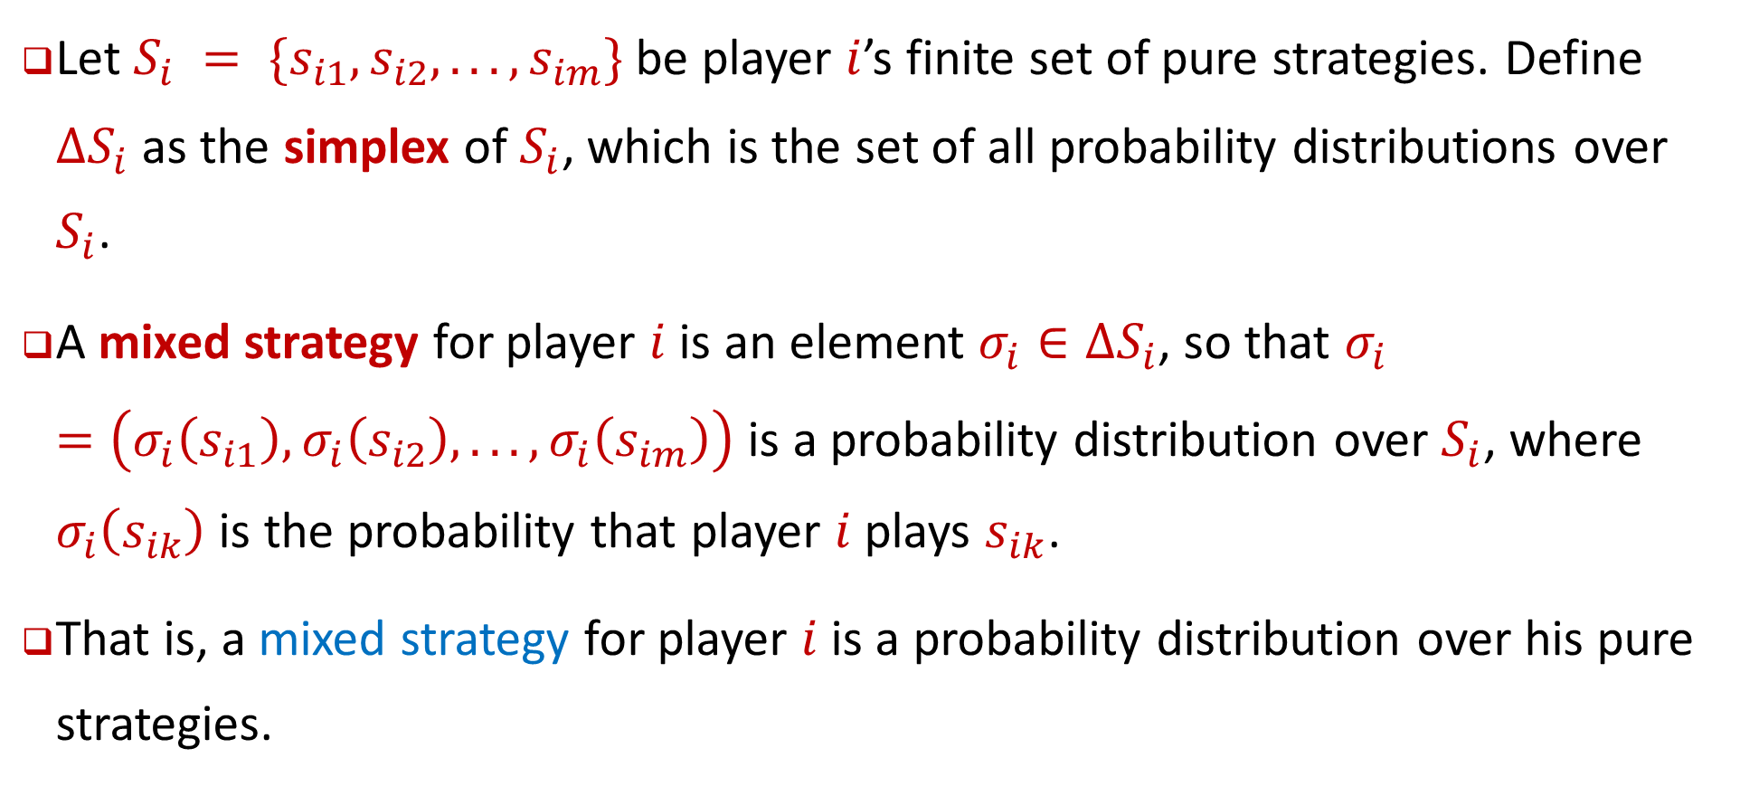
Definition 6.1 : mixed strategy
Let $S_{i} = \{s_{i1}, s_{i2}, . . . , s_{im}\}$ be player $i$’s finite set of pure strategies. Define ${∆S}_{i}$ as the simplex of $S_{i}$, which is the set of all probability distributions over $S_{i}$.
A mixed strategy for player $i$ is an element $σ_{i}∈{∆S}_{i}$, so that $σ_{i}=\left(σ_{i}\left(s_{i1}\right),σ_{i}\left(s_{i2}\right), . . . ,σ_{i}\left(s_{im}\right)\right)$ is a probability distribution over $S_{i}$, where $σ_{i}\left(s_{ik}\right)$ is the probability that player $i$ plays $s_{ik}$.
That is, a mixed strategy for player $i$ is a probability distribution over his pure strategies.

Slide 8
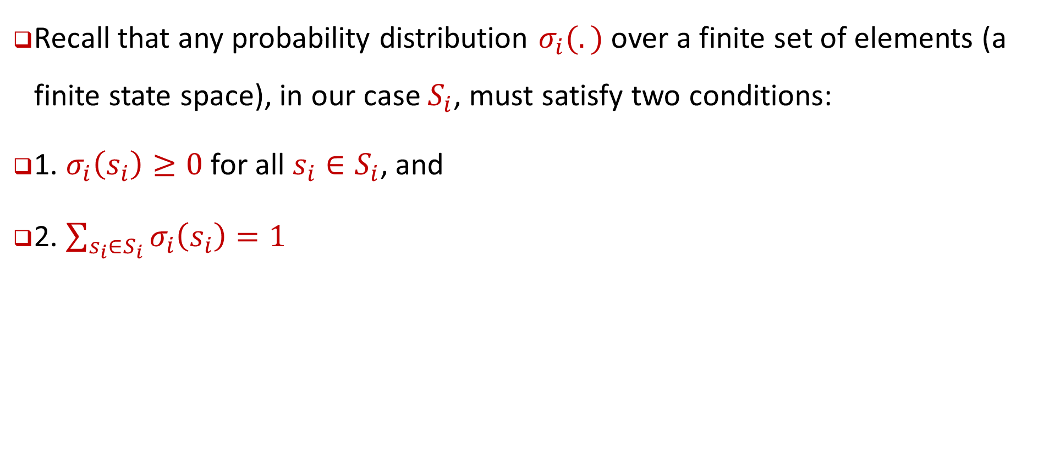
Definition 6.1 : mixed strategy
Recall that any probability distribution $σ_{i}(.)$ over a finite set of elements (a finite state space), in our case $S_{i}$, must satisfy two conditions:
1. $σ_{i}\left(s_{i}\right)≥0$ for all $s_{i}∈S_{i}$, and
2. $\sum_{s_{i}∈S_{i}}{σ_{i}\left(s_{i}\right)=1}$

Slide 9
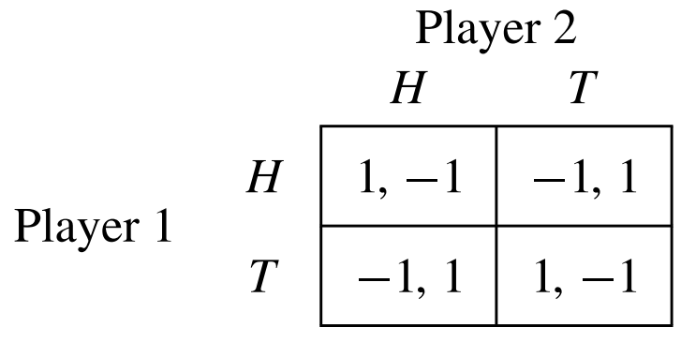
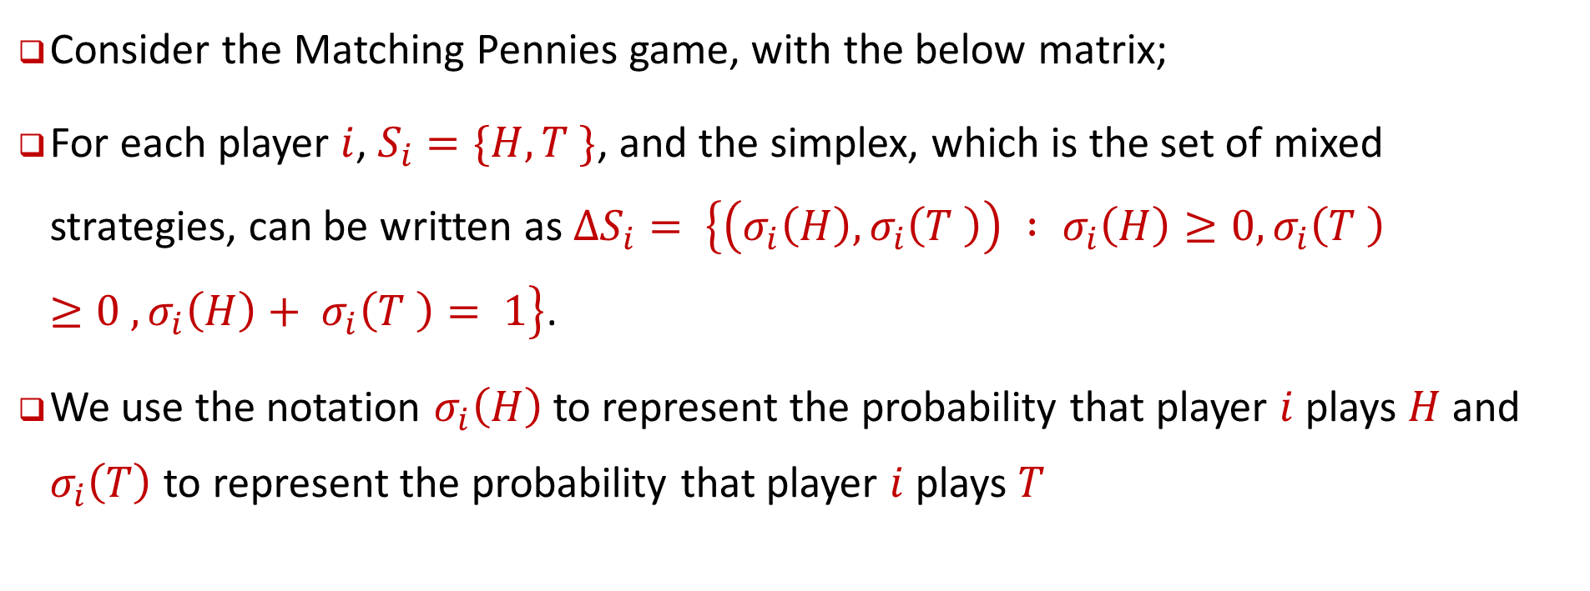
Example: mixed strategy
Consider the Matching Pennies game, with the below matrix;
For each player $i$, $S_{i}=\{H, T \}$, and the simplex, which is the set of mixed strategies, can be written as $∆S_{i}= \left\{\left(σ_{i}\left(H\right), σ_{i}\left(T \right)\right) : σ_{i}\left(H\right)≥0, σ_{i}\left(T \right)≥0 , σ_{i}\left(H\right)+ σ_{i}\left(T \right)= 1\right\}$.
We use the notation $σ_{i}\left(H\right)$to represent the probability that player $i$ plays $H$ and $σ_{i}\left(T\right)$to represent the probability that player $i$ plays $T$

Slide 10
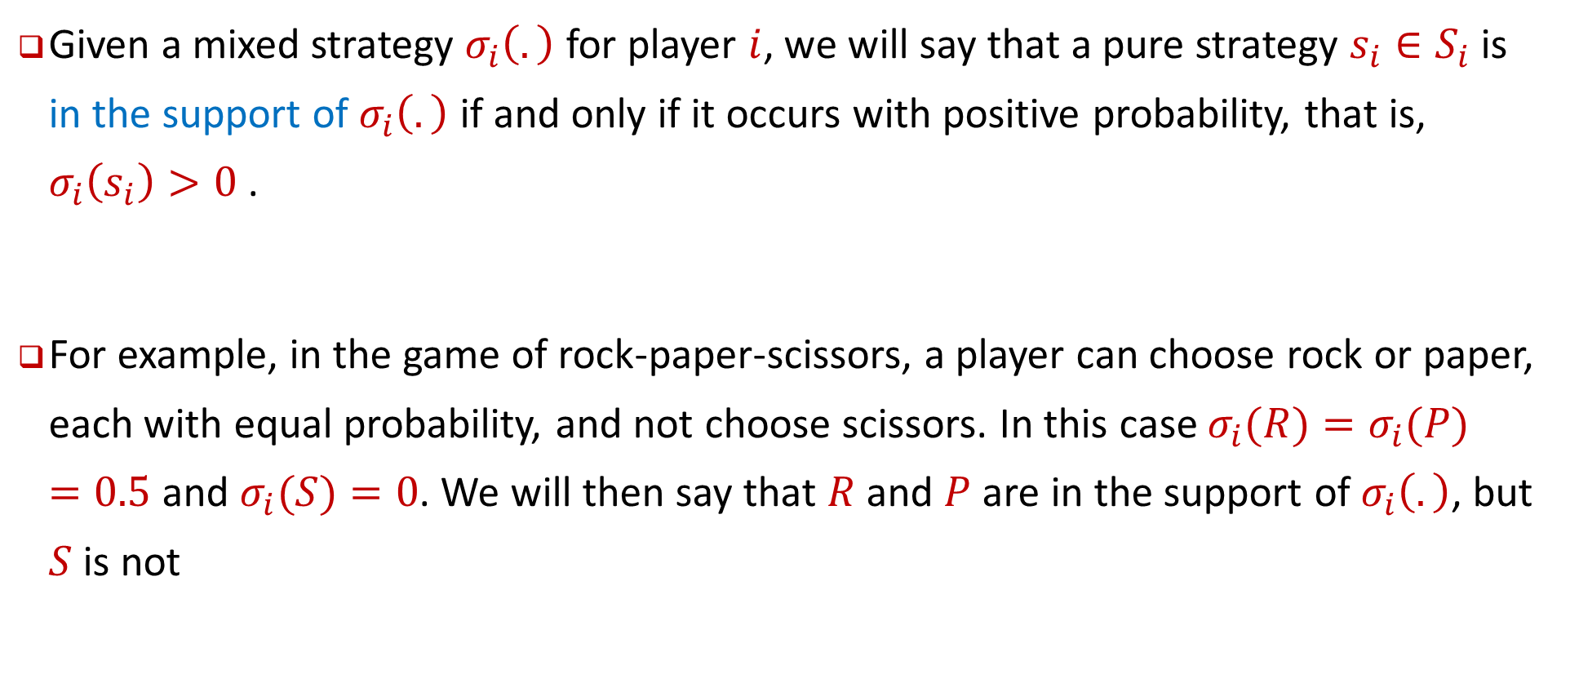
Definition 6.2 : mixed strategy
Given a mixed strategy $σ_{i}\left(.\right)$ for player $i$, we will say that a pure strategy $s_{i}∈S_{i}$ is in the support of $σ_{i}\left(.\right)$ if and only if it occurs with positive probability, that is, $σ_{i}\left(s_{i}\right)>0$.
For example, in the game of rock-paper-scissors, a player can choose rock or paper,
each with equal probability, and not choose scissors. In this case $σ_{i}(R)=σ_{i}(P) =0.5$ and $σ_{i}(S)=0$. We will then say that $R$ and $P$ are in the support of $σ_{i}\left(.\right)$, but $S$ is not

Slide 11
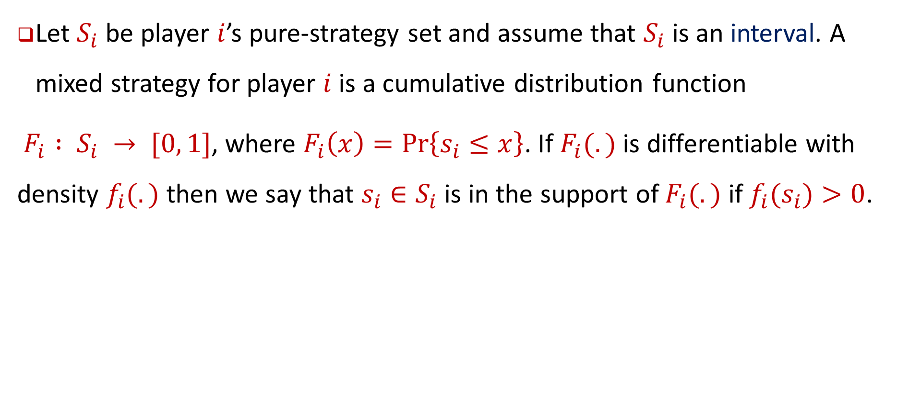
Definition 6.3 : Continuous Strategy Sets mixed strategy
Let $S_{i}$ be player $i$’s pure-strategy set and assume that $S_{i}$ is an interval. A mixed strategy for player $i$ is a cumulative distribution function
$F_{i} : S_{i} → [0, 1]$, where $F_{i}\left(x\right)=\operatorname{Pr}\left\{s_{i}≤x\right\}$. If $F_{i}(.)$ is differentiable with density $f_{i}(.)$ then we say that $s_{i}∈S_{i}$ is in the support of $F_{i}(.)$ if $f_{i}(s_{i})>0$.

Slide 12
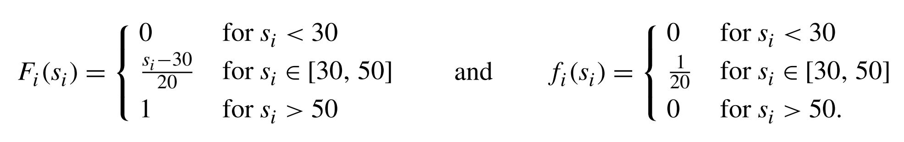
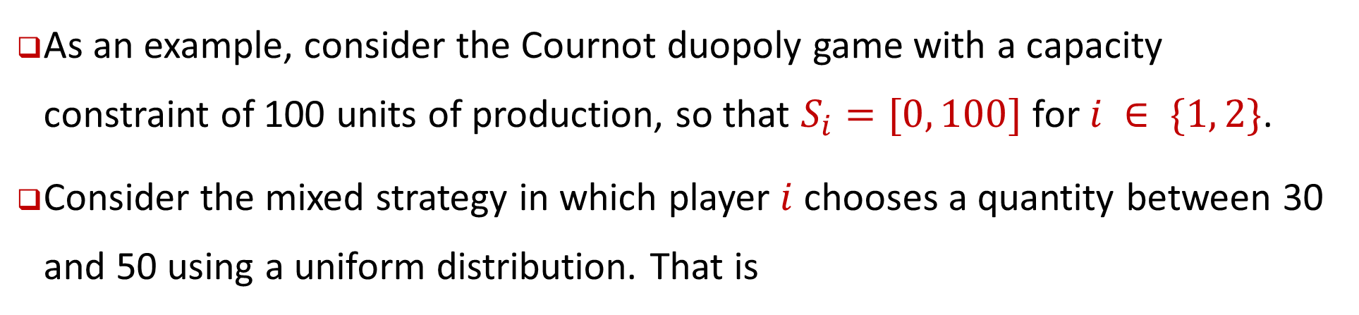
Example of Continuous Strategy Sets mixed strategy
As an example, consider the Cournot duopoly game with a capacity constraint of 100 units of production, so that $S_{i}=[0, 100]$ for $i ∈ \{1, 2\}$.
Consider the mixed strategy in which player $i$ chooses a quantity between 30 and 50 using a uniform distribution. That is

Slide 13
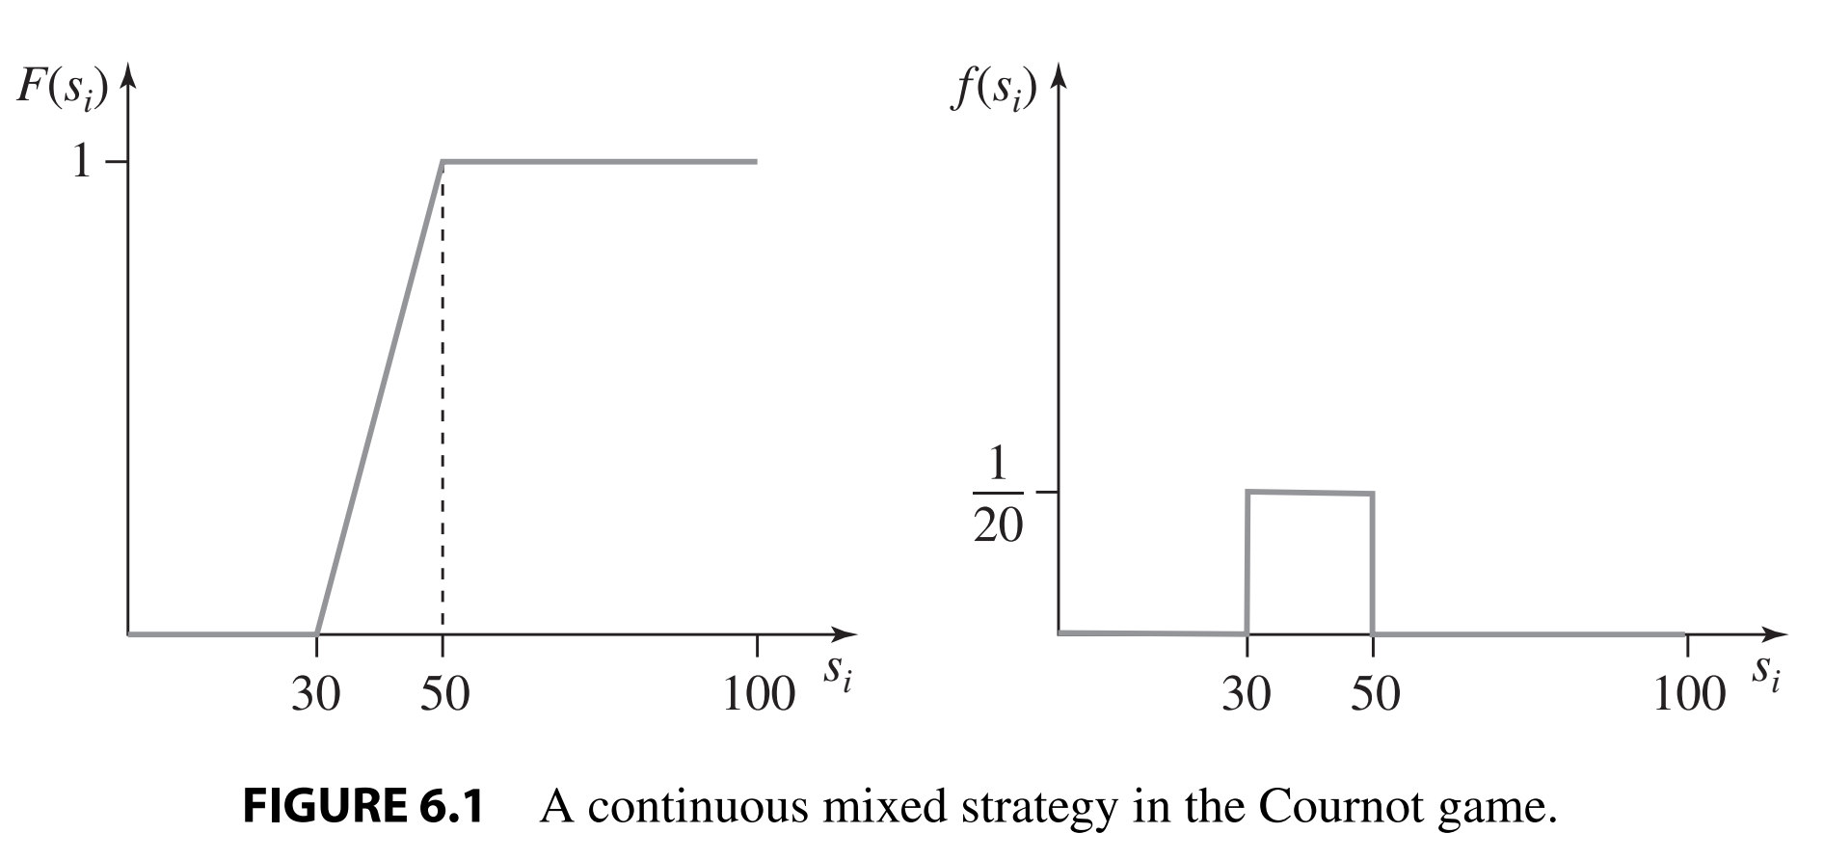
Example of Continuous Strategy Sets mixed strategy

Slide 14
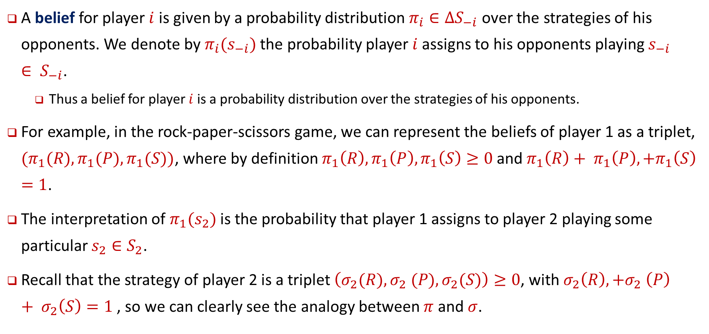
Definition 6.4 : a belief for player
A belief for player $i$ is given by a probability distribution $π_{i}∈∆S_{−i}$ over the strategies of his opponents. We denote by $π_{i}(s_{−i})$ the probability player $i$ assigns to his opponents playing $s_{−i}∈ S_{−i}$.
  Thus a belief for player $i$ is a probability distribution over the strategies of his opponents.
For example, in the rock-paper-scissors game, we can represent the beliefs of player 1 as a triplet, $(π_{1}(R), π_{1}(P), π_{1}(S))$, where by definition $π_{1}\left(R\right), π_{1}\left(P\right), π_{1}\left(S\right)≥0$ and $π_{1}\left(R\right)+ π_{1}\left(P\right),+π_{1}\left(S\right)=1$.
The interpretation of $π_{1}(s_{2})$ is the probability that player 1 assigns to player 2 playing some particular $s_{2}∈S_{2}$.
Recall that the strategy of player 2 is a triplet $\left(σ_{2}(R), σ_{2} (P), σ_{2}(S)\right)≥0$, with $σ_{2}\left(R\right),+σ_{2} \left(P\right)+ σ_{2}\left(S\right)=1$ , so we can clearly see the analogy between $π$ and $σ$.

Slide 15
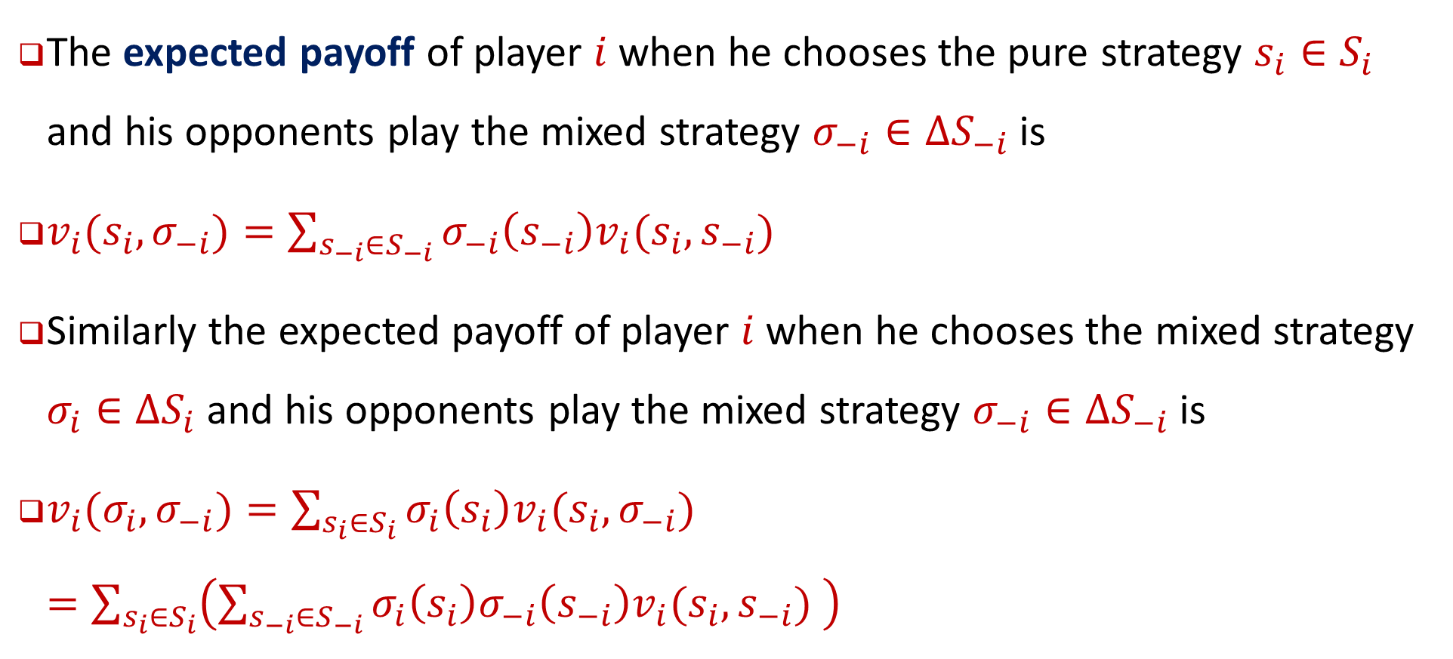
Definition 6.5: Expected Payoffs in mixed strategy
The expected payoff of player $i$ when he chooses the pure strategy $s_{i}∈S_{i}$ and his opponents play the mixed strategy $σ_{−i}∈∆S_{−i}$ is
$v_{i}(s_{i}, σ_{−i})=\sum_{s_{−i}∈S_{−i}}{σ_{−i}\left(s_{−i}\right)v_{i}(s_{i}, s_{−i}) }$
Similarly the expected payoff of player $i$ when he chooses the mixed strategy $σ_{i}∈∆S_{i}$ and his opponents play the mixed strategy $σ_{−i}∈∆S_{−i}$ is
$v_{i}(σ_{i}, σ_{−i})=\sum_{s_{i}∈S_{i}}{σ_{i}\left(s_{i}\right)v_{i}(s_{i}, σ_{−i}) }=\sum_{s_{i}∈S_{i}}{\left(\sum_{s_{−i}∈S_{−i}}{σ_{i}\left(s_{i}\right)σ_{−i}\left(s_{−i}\right)v_{i}(s_{i}, s_{−i}) }\right)}$

Slide 16
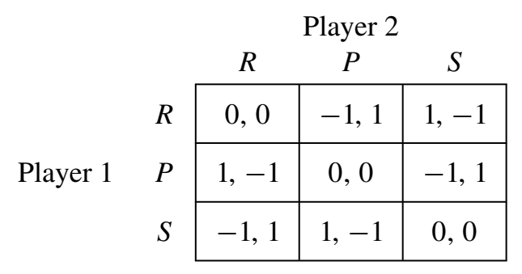
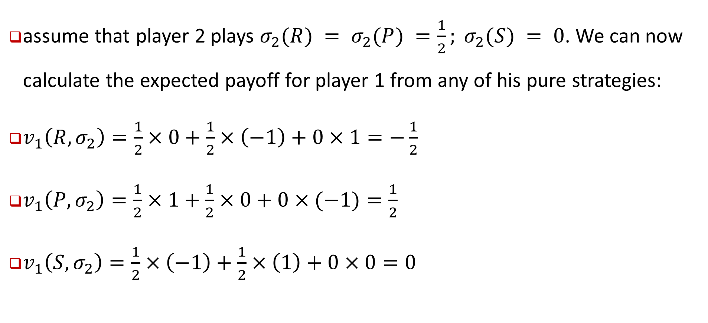
Example: recall the rock-paper-scissors game
assume that player 2 plays $σ_{2}(R) = σ_{2}(P) =\frac{1}{2}; σ_{2}(S) = 0$. We can now calculate the expected payoff for player 1 from any of his pure strategies:
$v_{1}\left(R, σ_{2}\right)=\frac{1}{2}×0+\frac{1}{2}×\left(−1\right)+0×1=−\frac{1}{2}$
$v_{1}\left(P, σ_{2}\right)=\frac{1}{2}×1+\frac{1}{2}×0+0×(−1)=\frac{1}{2}$
$v_{1}\left(S, σ_{2}\right)=\frac{1}{2}×\left(−1\right)+\frac{1}{2}×\left(1\right)+0×0=0$
unique best response to this mixed strategy

Slide 17
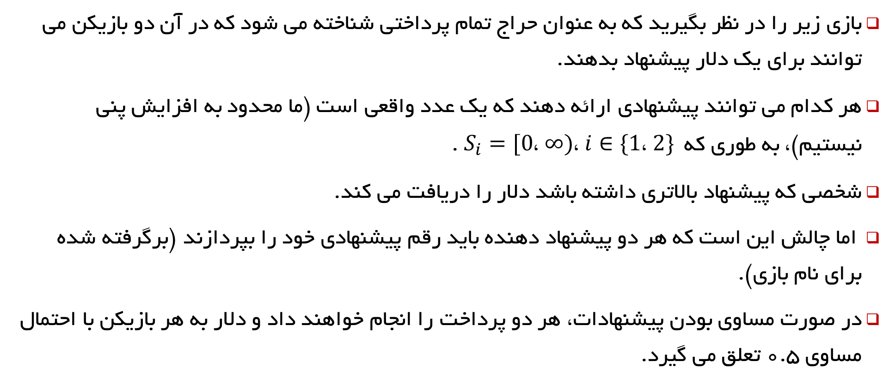
all-pay auction
بازی زیر را در نظر بگیرید که به عنوان حراج تمام پرداختی شناخته می شود که در آن دو بازیکن می توانند برای یک دلار پیشنهاد بدهند.
هر کدام می توانند پیشنهادی ارائه دهند که یک عدد واقعی است (ما محدود به افزایش پنی نیستیم)، به طوری که $S_{i}=[0، ∞)، i∈\{1، 2\}$ .
شخصی که پیشنهاد بالاتری داشته باشد دلار را دریافت می کند.
اما چالش این است که هر دو پیشنهاد دهنده باید رقم پیشنهادی خود را بپردازند (برگرفته شده برای نام بازی).
در صورت مساوی بودن پیشنهادات، هر دو پرداخت را انجام خواهند داد و دلار به هر بازیکن با احتمال مساوی 0.5 تعلق می گیرد.

Slide 18
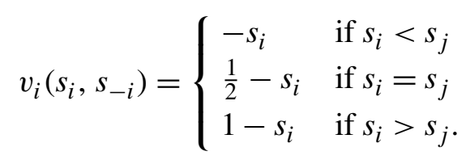

all-pay auction
بنابراین، اگر بازیکن $i$ پیشنهاد $s_{i}$ و بازیکن $j ≠i$ نیز $s_{j}$ را پیشنهاد دهد، پس سود بازیکن $i$ برابر است با:

Slide 19
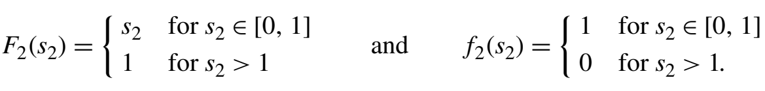
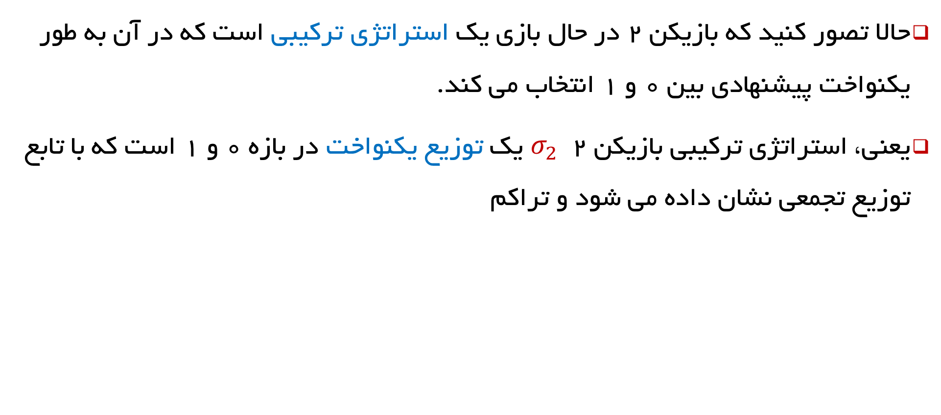



all-pay auction in mixed mode
حالا تصور کنید که بازیکن 2 در حال بازی یک استراتژی ترکیبی است که در آن به طور یکنواخت پیشنهادی بین 0 و 1 انتخاب می کند.
یعنی، استراتژی ترکیبی بازیکن 2 $σ_{2}$ یک توزیع یکنواخت در بازه 0 و 1 است که با تابع توزیع تجمعی نشان داده می شود و تراکم
$$F_{2}\left(s_{2}\right)$$
$$1$$
$$s_{2}$$

Slide 20
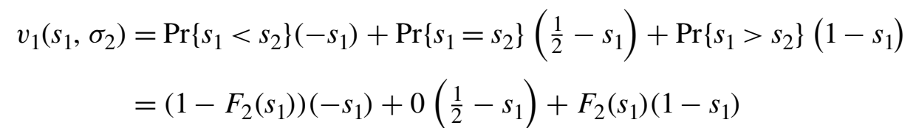

all-pay auction in mixed mode
بازده مورد انتظار بازیکن 1 از ارائه پیشنهاد این است که $s_{i}>1$ برابر است با ${1−s}_{i}<0$ زیرا او مطمئناً برنده خواهد شد، اما این عاقلانه نخواهد بود.
سود مورد انتظار از پیشنهاد $s_{i}<1$ است
$$=−s_{1}+F_{2}\left(s_{1}\right)=−s_{1}+s_{1}=0$$

Slide 21
all-pay auction in mixed mode
بنابراین هنگامی که بازیکن 2 از توزیع یکنواخت بین 0 و 1 برای پیشنهاد خود استفاده می کند، بازیکن 1 نمی تواند از هر پیشنهادی که ارائه می دهد، بازده مورد انتظار مثبتی دریافت کند:
هر پیشنهادی کمتر از 1 سود مورد انتظار 0 را ارائه می دهد و هر پیشنهادی بالاتر از 1 دریافت دلار با قیمتی متورم خواهد بود.
این بازی یکی از مواردی است که در ادامه به آن باز خواهیم گشت.

Slide 22
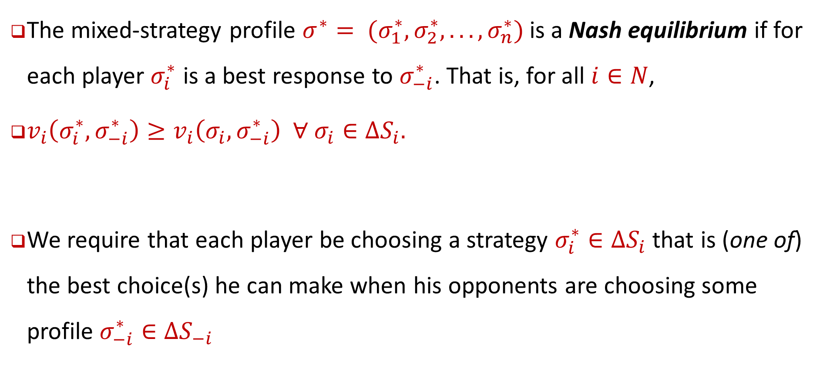
Definition 6.6: Mixed-Strategy Nash Equilibrium
The mixed-strategy profile $σ^{∗}= (σ_{1}^{∗},σ_{2}^{∗}, . . . ,σ_{n}^{∗})$is a Nash equilibrium if for each player $σ_{i}^{∗}$ is a best response to $σ_{−i}^{∗}$. That is, for all $i∈N$,
$v_{i}\left(σ_{i}^{∗},σ_{−i}^{∗}\right)≥v_{i}\left(σ_{i},σ_{−i}^{∗}\right) ∀ σ_{i}∈∆S_{i}.$
We require that each player be choosing a strategy $σ_{i}^{∗}∈∆S_{i}$that is (one of) the best choice(s) he can make when his opponents are choosing some profile $σ_{−i}^{∗}∈∆S_{−i}$

Slide 23
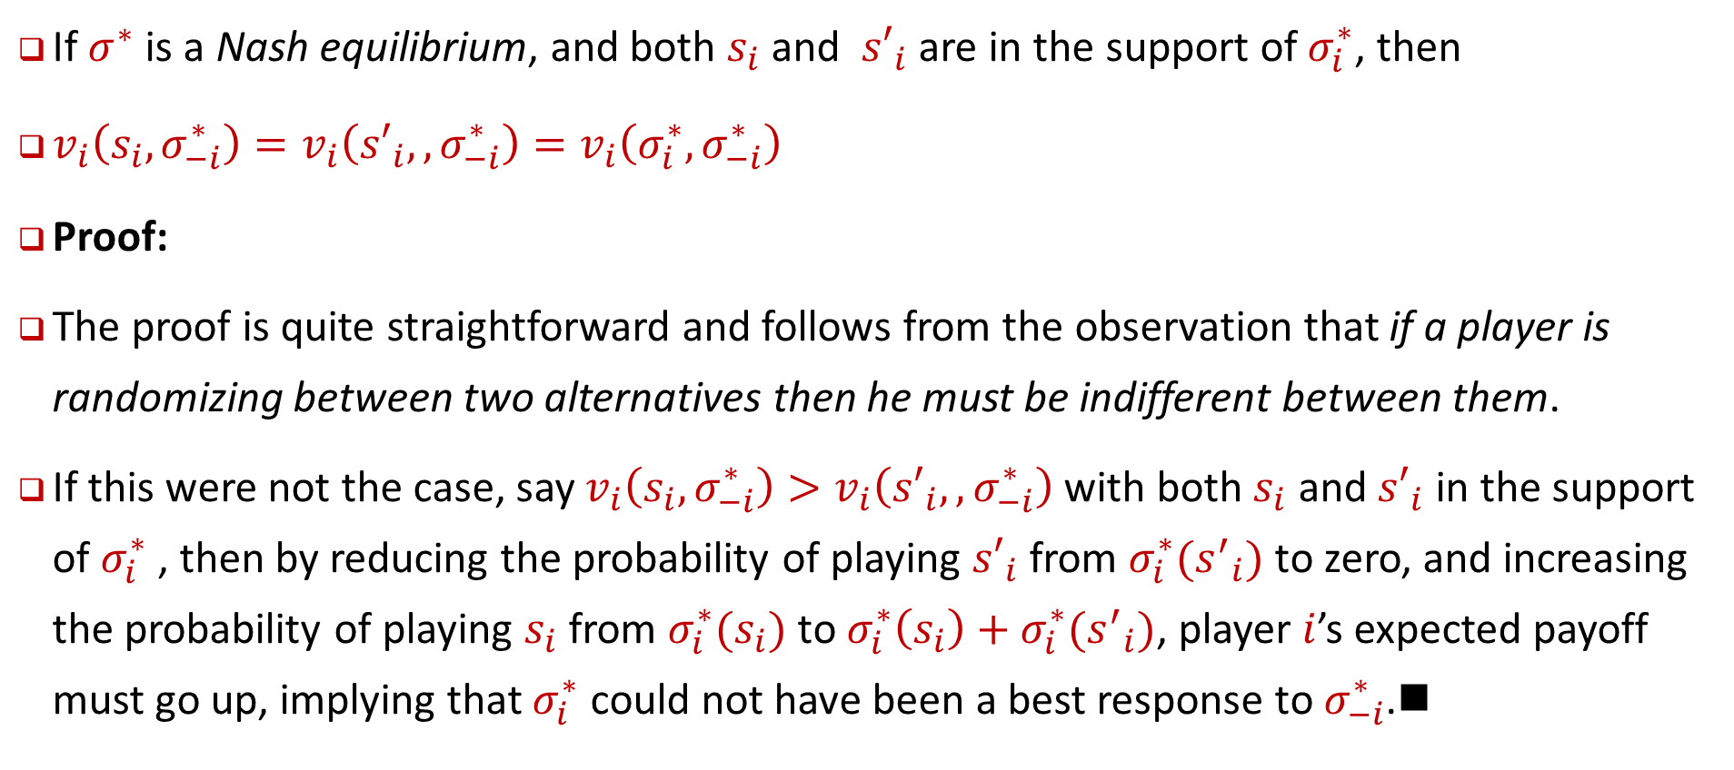
Proposition 6.1
If $σ^{∗}$ is a Nash equilibrium, and both $s_{i}$ and ${s′}_{i}$ are in the support of $σ_{i}^{∗}$, then
$v_{i}\left(s_{i},σ_{−i}^{∗}\right)=v_{i}\left({s′}_{i},,σ_{−i}^{∗}\right)=v_{i}\left(σ_{i}^{∗},σ_{−i}^{∗}\right)$
Proof:
The proof is quite straightforward and follows from the observation that if a player is randomizing between two alternatives then he must be indifferent between them.
If this were not the case, say $v_{i}\left(s_{i},σ_{−i}^{∗}\right)>v_{i}\left({s′}_{i},,σ_{−i}^{∗}\right)$with both $s_{i}$ and ${s′}_{i}$ in the support of $σ_{i}^{∗}$ , then by reducing the probability of playing ${s′}_{i}$ from $σ_{i}^{∗}({s^{′}}_{i})$ to zero, and increasing the probability of playing $s_{i}$ from $σ_{i}^{∗}(s_{i})$ to $σ_{i}^{∗}\left(s_{i}\right)+σ_{i}^{∗}({s^{′}}_{i})$, player $i$’s expected payoff must go up, implying that $σ_{i}^{∗}$ could not have been a best response to $σ_{−i}^{∗}$.

Slide 24
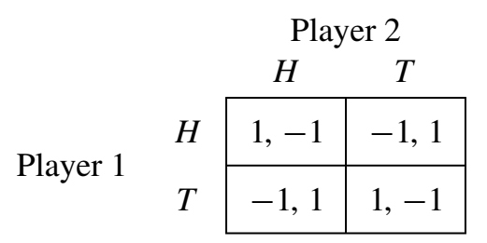
Example: Matching Pennies
به یاد بیاورید که ما نشان دادیم که این بازی یک تعادل نش با استراتژی خالص ندارد.
اکنون می‌پرسیم، آیا تعادل نش با استراتژی مختلط دارد؟
برای پاسخ به این، باید استراتژی های ترکیبی برای هر دو بازیکن پیدا کنیم که بهترین پاسخ های متقابل باشد.

Slide 25
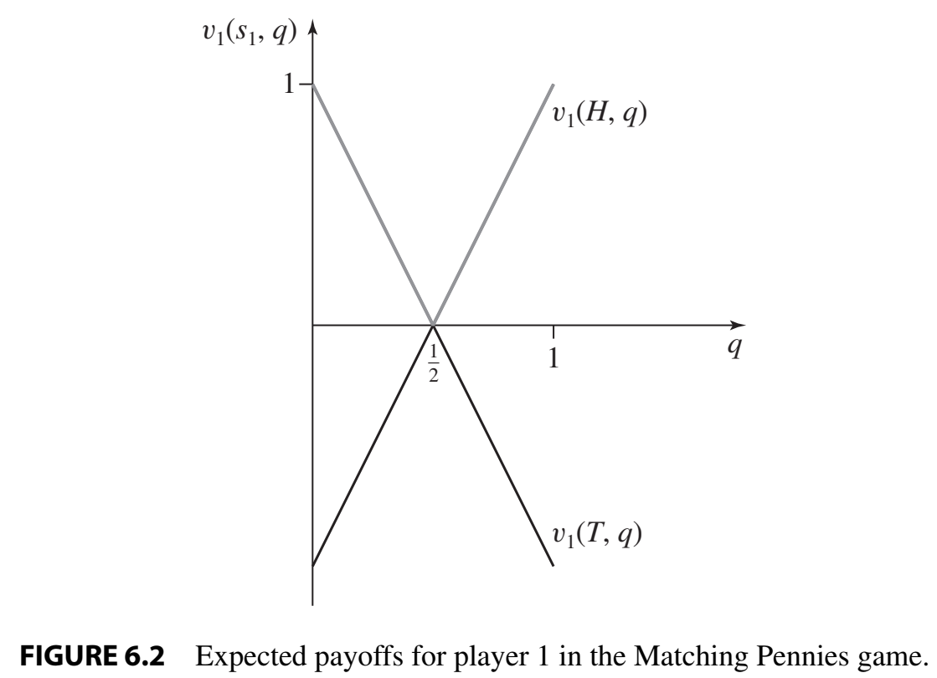
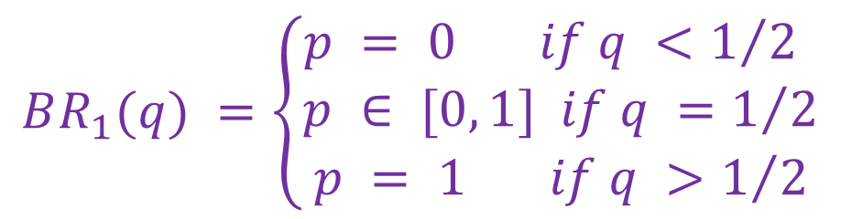
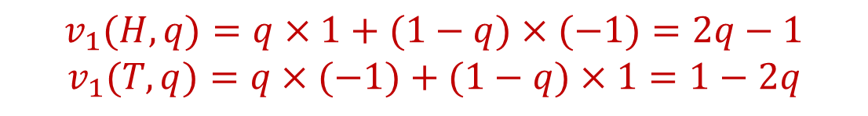
Example: Matching Pennies
Let p be the probability that player 1 plays H and 1− p the probability that he plays T.
Similarly let q be the probability that player 2 plays H and 1− q the probability that he plays T.
$$v_{1}(H, q)=q×1+(1−q)×(−1)=2q−1$$
$$v_{1}(T, q)=q×(−1)+(1−q)×1=1−2q$$
$$BR_{1}(q) =\left\{\begin{aligned}p = 0 if q <1/2 \\ p ∈ [0, 1] if q =1/2 \\ p = 1 if q >1/2\end{aligned}\right.$$

Slide 26
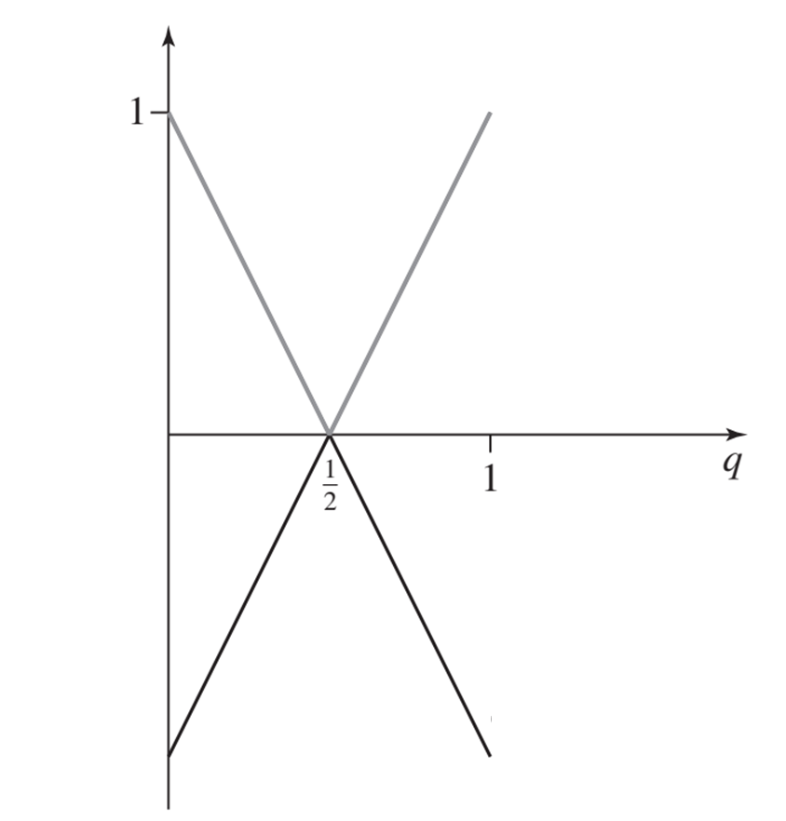
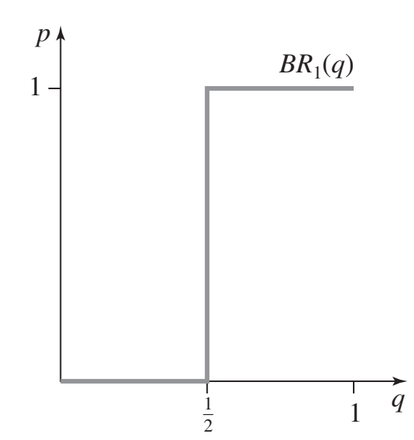
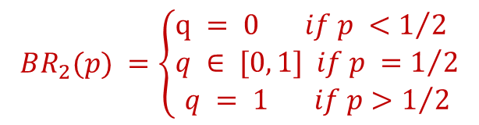

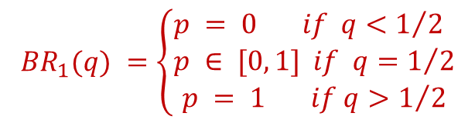

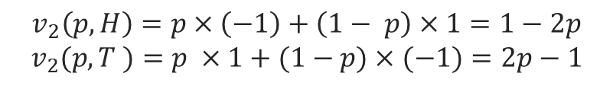


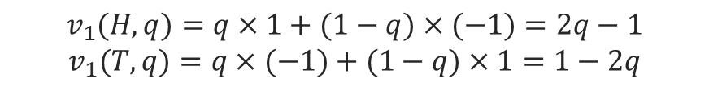
Example: Matching Pennies
$$v_{2}(p,s_{2})$$
$$v_{2}(p, T)$$
$$v_{1}(H, q)=q×1+(1−q)×(−1)=2q−1$$
$$v_{1}(T, q)=q×(−1)+(1−q)×1=1−2q$$
$$v_{2}\left(p, H\right)=p×\left(−1\right)+\left(1− p\right)×1=1−2p$$
$$v_{2}(p, T )=p ×1+(1−p)×(−1)=2p−1$$
$$v_{2}(p, H)$$
$$BR_{1}(q) =\left\{\begin{aligned}p = 0 if q<1/2 \\ p ∈ [0, 1] if q=1/2 \\ p = 1 if q>1/2\end{aligned}\right.$$
$$BR_{2}(p)$$
$$BR_{2}(p) =\left\{\begin{aligned}q = 0 if p <1/2 \\ q ∈ [0, 1] if p =1/2 \\ q = 1 if p>1/2\end{aligned}\right.$$

Slide 27

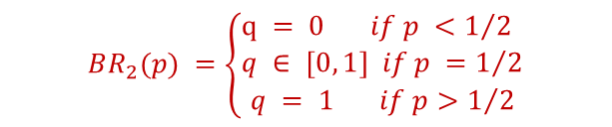

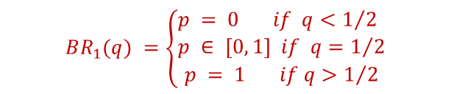
Example: Matching Pennies
$$BR_{1}(q) =\left\{\begin{aligned}p = 0 if q<1/2 \\ p ∈ [0, 1] if q=1/2 \\ p = 1 if q>1/2\end{aligned}\right.$$
$$BR_{2}(p) =\left\{\begin{aligned}q = 0 if p <1/2 \\ q ∈ [0, 1] if p =1/2 \\ q = 1 if p>1/2\end{aligned}\right.$$
$$BR_{2}(p)$$
$$BR_{2}(p)$$
Nash $p^{∗}=q^{∗}=\frac{1}{2}$

Slide 28
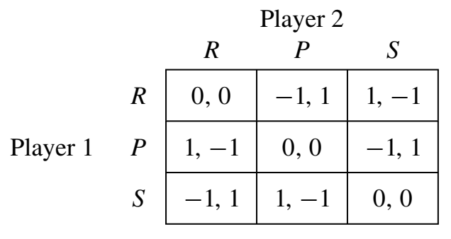
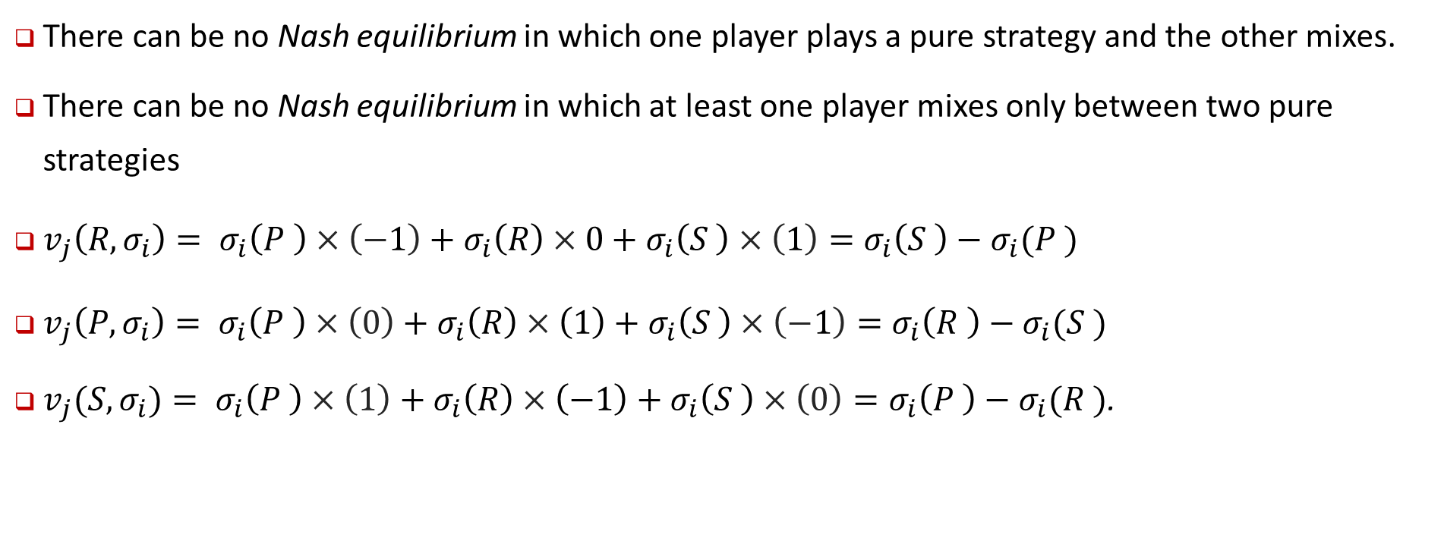
Example: Rock-Paper-Scissors
There can be no Nash equilibrium in which one player plays a pure strategy and the other mixes.
There can be no Nash equilibrium in which at least one player mixes only between two pure strategies
$v_{j}\left(R, σ_{i}\right)= σ_{i}\left(P \right)×\left(−1\right)+σ_{i}\left(R\right)×0+σ_{i}\left(S \right)×\left(1\right)=σ_{i}\left(S \right)−σ_{i}(P )$
$v_{j}\left(P, σ_{i}\right)= σ_{i}\left(P \right)×\left(0\right)+σ_{i}\left(R\right)×\left(1\right)+σ_{i}\left(S \right)×\left(−1\right)=σ_{i}\left(R \right)−σ_{i}(S )$
$v_{j}(S, σ_{i})= σ_{i}\left(P \right)×\left(1\right)+σ_{i}\left(R\right)×\left(−1\right)+σ_{i}\left(S \right)×\left(0\right)=σ_{i}\left(P \right)−σ_{i}(R )$.

Slide 29

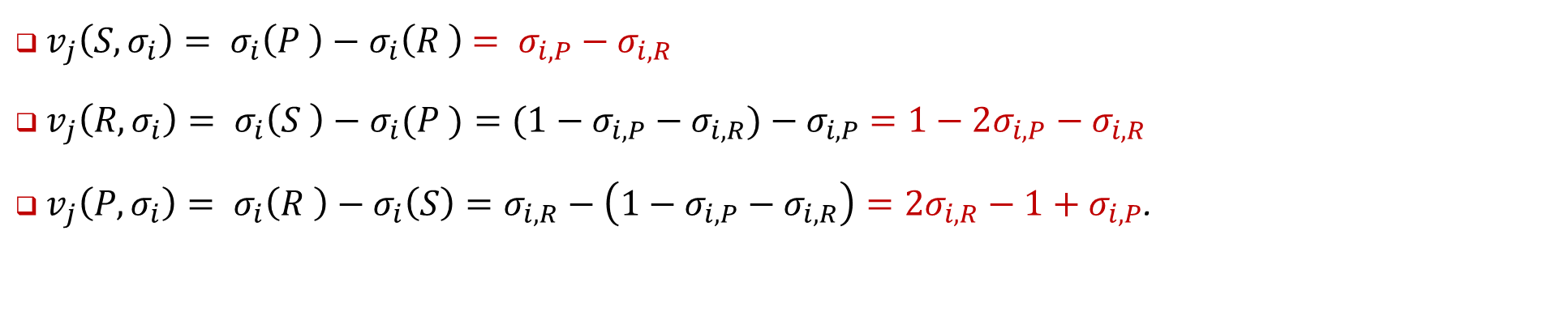


Example: Rock-Paper-Scissors
$v_{j}\left(S, σ_{i}\right)= σ_{i}\left(P \right)−σ_{i}\left(R \right)$ $= σ_{i,P}−σ_{i,R}$
$v_{j}\left(R, σ_{i}\right)= σ_{i}\left(S \right)−σ_{i}(P )=(1−σ_{i,P}−σ_{i,R})−σ_{i,P}$ $=1−2σ_{i,P}−σ_{i,R}$
$v_{j}\left(P, σ_{i}\right)= σ_{i}\left(R \right)−σ_{i}\left(S\right)=σ_{i,R}−\left(1−σ_{i,P}−σ_{i,R}\right)=2σ_{i,R}−1+σ_{i,P}$.
$$v_{j}\left(S, σ_{i}\right)$$
$$v_{j}\left(R, σ_{i}\right)$$
$$v_{j}\left(P, σ_{i}\right)$$

Slide 30
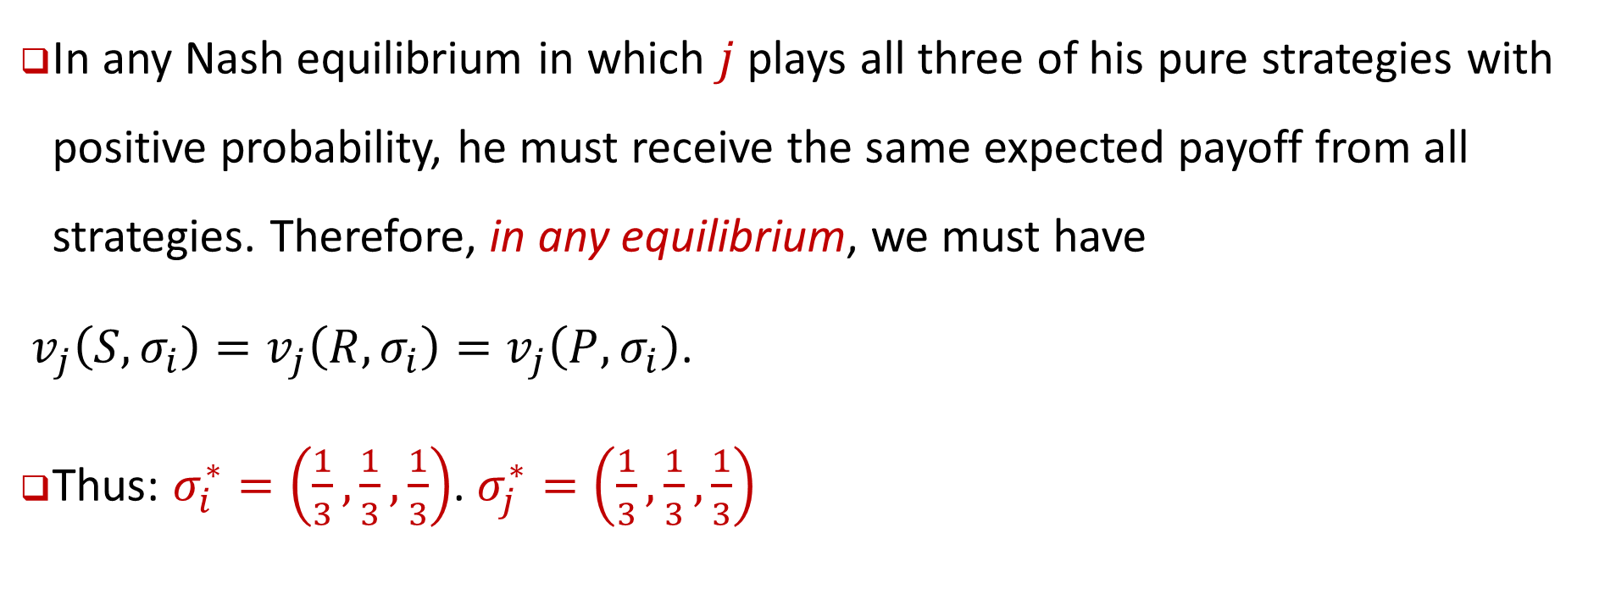
Example: Rock-Paper-Scissors
In any Nash equilibrium in which $j$ plays all three of his pure strategies with positive probability, he must receive the same expected payoff from all strategies. Therefore, in any equilibrium, we must have
$v_{j}\left(S, σ_{i}\right)=v_{j}\left(R, σ_{i}\right)=v_{j}\left(P, σ_{i}\right)$.
Thus: $σ_{i}^{∗}=\left(\frac{1}{3},\frac{1}{3},\frac{1}{3}\right)$. $σ_{j}^{∗}=\left(\frac{1}{3},\frac{1}{3},\frac{1}{3}\right)$

Slide 31
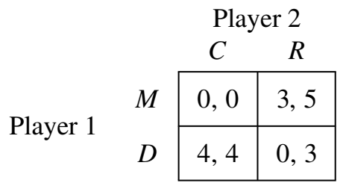
تعادل چندگانه: خالص و ترکیبی
Multiple Equilibria: Pure and Mixed
در بازی های تشابه سکه و سنگ-کاغذ-قیچی، تعادل منحصر به فرد نش، یک تعادل نش با استراتژی ترکیبی بود.
وقتی یک بازی دارای چندین تعادل نش با استراتژی خالص است، تقریباً همیشه تعادل های نش دیگری را در استراتژی های ترکیبی خواهد داشت.
بازی زیر را در نظر بگیرید
(M, R) و (D, C) هر دو تعادل نش با استراتژی خالص هستند

Slide 32
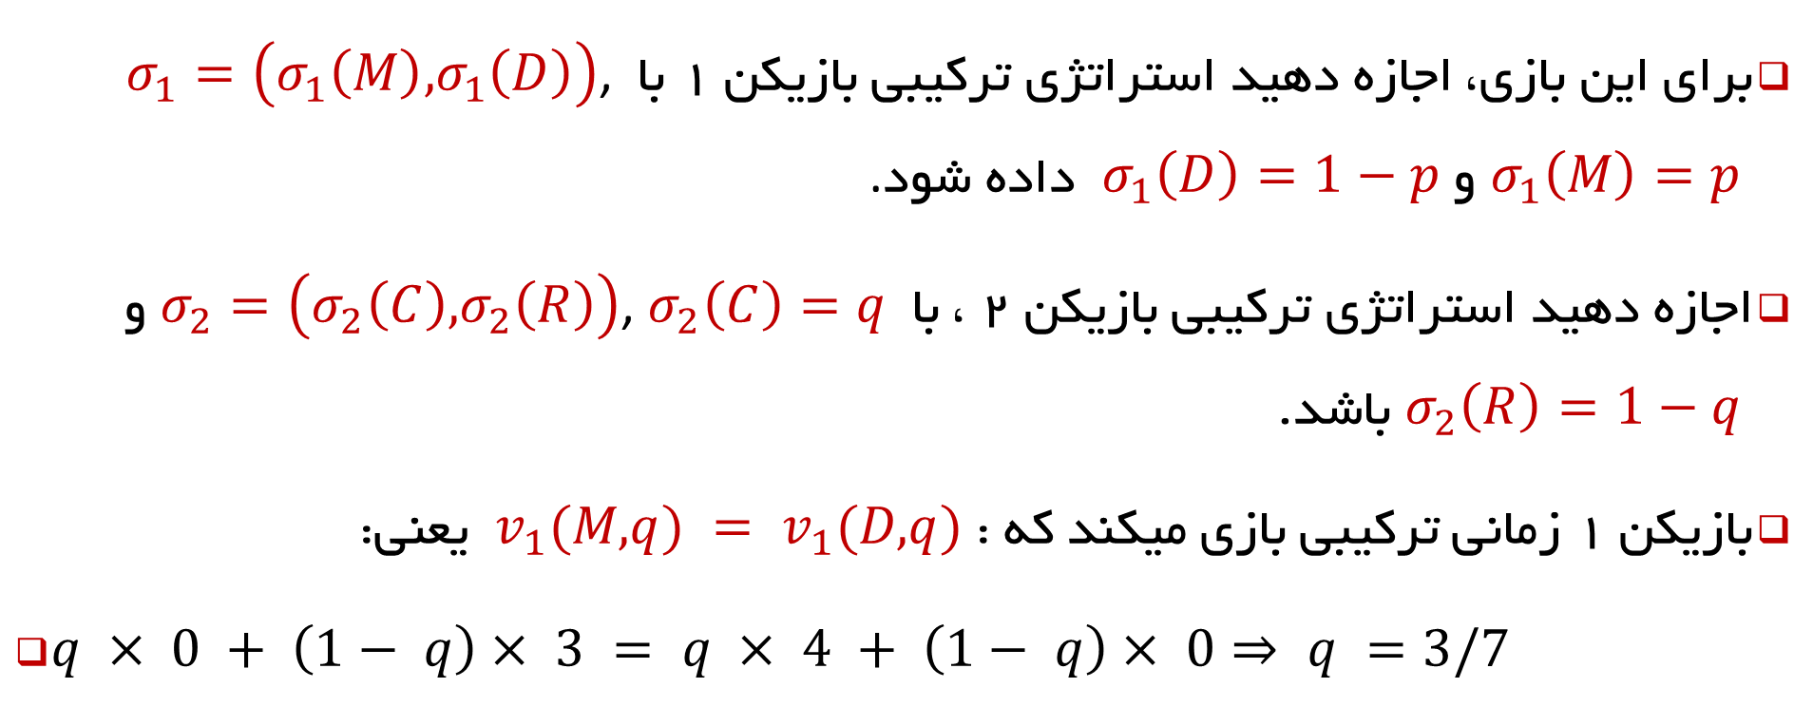
تعادل چندگانه: خالص و ترکیبی
Multiple Equilibria: Pure and Mixed
برای این بازی، اجازه دهید استراتژی ترکیبی بازیکن 1 با $σ_{1}=\left(σ_{1}\left(M\right), σ_{1}\left(D\right)\right)$, $σ_{1}\left(M\right)=p$ و $σ_{1}\left(D\right)=1−p$ داده شود.
اجازه دهید استراتژی ترکیبی بازیکن 2 ، با $σ_{2}=\left(σ_{2}\left(C\right), σ_{2}\left(R\right)\right)$, $σ_{2}\left(C\right)=q$ و $σ_{2}\left(R\right)=1−q$ باشد.
بازیکن 1 زمانی ترکیبی بازی میکند که : $v_{1}(M, q) = v_{1}(D, q)$ یعنی:
$q × 0 + \left(1− q\right)× 3 = q × 4 + \left(1− q\right)× 0⇒ q =3/7$

Slide 33
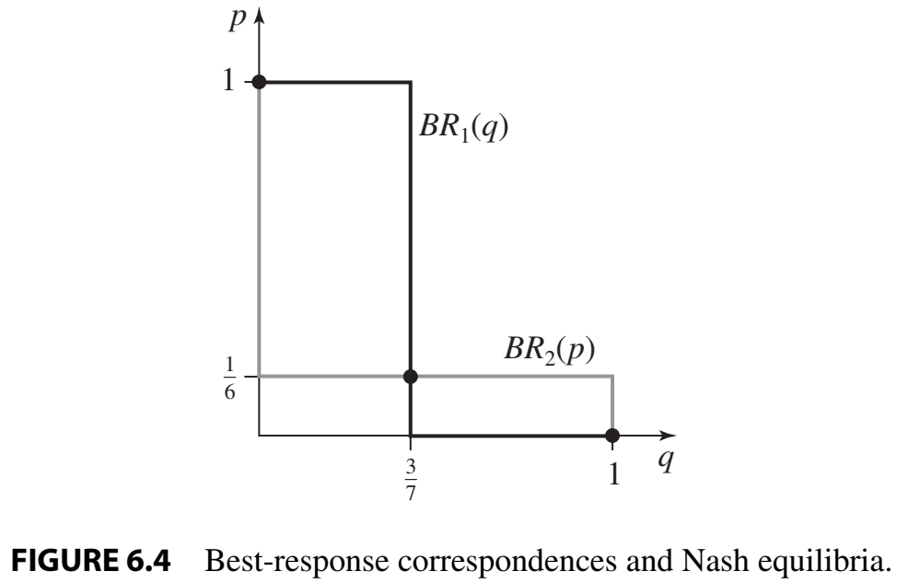
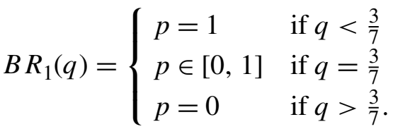
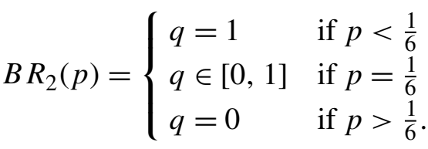
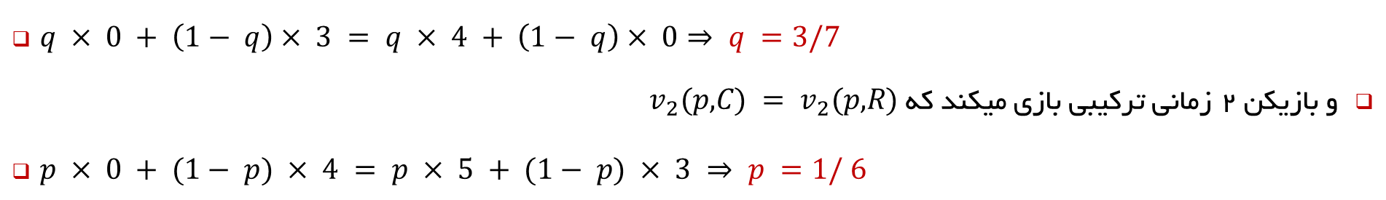
تعادل چندگانه: خالص و ترکیبی
Multiple Equilibria: Pure and Mixed
$q × 0 + \left(1− q\right)× 3 = q × 4 + \left(1− q\right)× 0⇒ q =3/7$
و بازیکن 2 زمانی ترکیبی بازی میکند که $v_{2}(p, C) = v_{2}(p, R)$
$p × 0 + (1− p) × 4 = p × 5 + (1− p) × 3 ⇒ p =1/ 6$

Slide 34

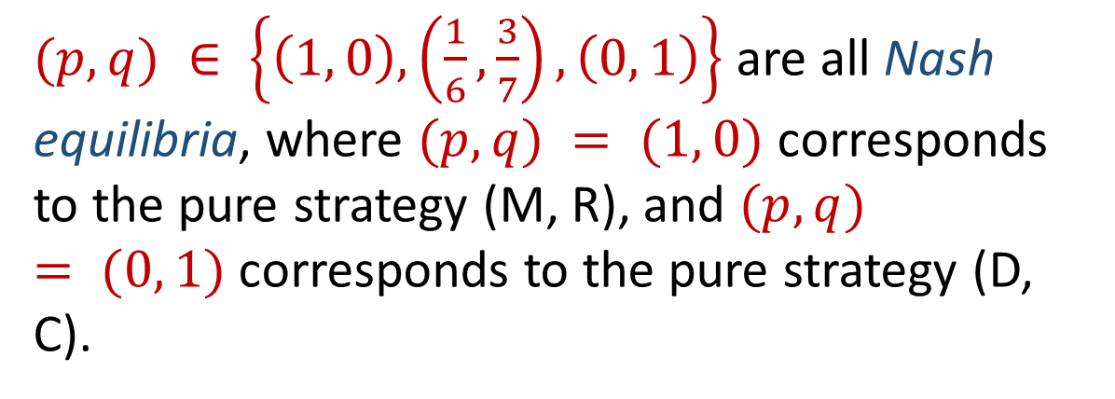
تعادل چندگانه: خالص و ترکیبی
Multiple Equilibria: Pure and Mixed
سومین نقطه تعادل نش این بازی بصورت ترکیبی خواهد بود:
$\left(σ_{1}^{∗},σ_{2}^{∗}\right) =\left(\left(\frac{1}{6},\frac{5}{6}\right),\left(\frac{3}{7},\frac{4}{7}\right)\right)$
$(p, q) ∈ \left\{\left(1, 0\right),\left(\frac{1}{6},\frac{3}{7}\right), \left(0, 1\right)\right\}$ are all Nash equilibria, where $(p, q) = (1, 0)$ corresponds to the pure strategy (M, R), and $(p, q) = (0, 1)$corresponds to the pure strategy (D, C).

Slide 35

Mixed strategy dominance
Definition 6.7: Let $σ_{i}∈∆S_{i}$and $s_{i}∈S_{i}$ be possible strategies for player $i$. We say that $s_{i}$ is strictly dominated by $σ_{i}$ if $v_{i}(σ_{i}, s_{−i})>v_{i}(s_{i}, s_{−i}) ∀s_{−i}∈S_{−i}$.
Definition 6.8: A strategy $σ_{i}∈∆S_{i}$ is never a best response if there are no beliefs $σ_{−i}∈∆S_{−i}$ for player $i$ for which $σ_{i}∈BR_{i}(σ_{−i})$.

Slide 36



Mixed strategy dominance
Consider the following game and denote mixed strategies for players 1 and 2 as triplets, $\left(σ_{1}\left(U\right), σ_{1}\left(M\right), σ_{1}\left(D\right)\right)$ and $\left(σ_{2}\left(L\right), σ_{2}\left(C\right), σ_{2}\left(R\right)\right)$, respectively.
we can find that the strategy $L$ for player 2 is strictly dominated by a strategy that mixes between the pure strategies $C$ and $R$. That is, $(σ_{2}(L), σ_{2}(C), σ_{2}(R)) =(0, 0.5,0.5)$

Slide 37




Mixed strategy dominance
As showed in previous example $(p, q) ∈ \left\{\left(1, 0\right),\left(\frac{1}{6},\frac{3}{7}\right), \left(0, 1\right)\right\}$ are all Nash equilibria

Slide 38

Nash’s Existence Theorem
Theorem (Nash’s Existence Theorem): Any $n$-player normal-form game with finite strategy sets $S_{i}$ for all players has a (Nash) equilibrium in mixed strategies.
علیرغم اینکه اثبات تعادل نش، کمی فنی است، ولی یک نسخه محدود از این قضیه را اثبات خواهیم کرد.
ایده اصلی اثبات نش بر پایه چیزی است که در ریاضیات به عنوان قضیه نقطه ثابت شناخته می شود. اساسی ترین این قضایا به عنوان Brouwer’s fixed-point theorem شناخته می شود:

Slide 39

Theorem (Brouwer’s Fixed-Point Theorem)
If $f (x)$ is a continuous function from the domain [0, 1] to itself then there exists at least one value $x^{∗}∈[0, 1]$for which $f(x^{∗})=x^{∗}$.
That is, if $f(x)$ takes values from the interval $[0, 1]$ and generates results from this same interval (or $f :[0, 1]→[0, 1]$) then there has to be some value $x^{∗}$ in the interval [0, 1] for which the operation of $f (.)$ on $x^{∗}$ will give back the same value, $f(x^{∗})=x^{∗}$. The intuition behind the proof of this theorem is actually quite simple.

Slide 40

Luitzen Egbertus Jan Brouwer
L. E. J. Brouwer
Born: Luitzen Egbertus Jan Brouwer(27 February 1881)
Overschie, Netherlands
Died : 2 December 1966 (aged 85)- Blaricum, Netherlands
Nationality : Dutch

Slide 41

Theorem (Brouwer’s Fixed-Point Theorem)
First, because f : [0, 1] → [0, 1] maps the interval [0, 1] onto itself, then 0 ≤ f (x) ≤ 1 for any x ∈ [0, 1]. Second, note that if f (0) = 0 then x∗ = 0, while if f (1) = 1 then x∗ = 1 (as shown by the function f1(x) in Figure 6.5). We need to show, therefore, that if f (0) > 0 and f (1) < 1 then when f (x) is continuous there must be some value x∗ for which f (x∗) = x∗. To see this consider the two functions, f2(x) and f3(x), depicted in Figure 6.5, both of which map the interval [0, 1] onto itself, and for which f (0) > 0 and f (1) < 1. That is, these functions start above the 45◦ line and end below it. The function f2(x) is continuous, and hence if it starts above the 45◦ line and ends below it, it must cross it at least once. In the figure, this happens at the value of x∗. To see why the continuity assumption is important, consider the function f3(x) depicted in Figure 6.5. Notice that it “jumps” down from above the 45◦ line to right below it, and hence this function does not cross the 45◦ line, in which case there is no value x for which f (x) = x.

Slide 42

Definition 6.9 : collection of best-response correspondences
The collection of best-response correspondences, $BR≡BR_{1}×BR_{2}×…×BR_{n}$, maps $∆S=∆S_{1}×…×∆S_{n}$, the set of profiles of mixed strategies, onto itself. That is, $BR :∆S⇉∆S$ takes every element $σ∈∆S$ and converts it into a subset $BR\left(σ^{′}\right)⊂∆S$.
Fact: A mixed-strategy profile $σ^{∗} ∈∆S$is a Nash equilibrium if and only if it is a fixed point of the collection of best-response correspondences,
$σ^{∗}∈BR\left(σ^{∗}\right)$.

Slide 43

Theorem 6.1 (Kakutani’s Fixed-Point Theorem)
A correspondence $C :X⇉X$has a fixed point $x∈C(x)$ if four conditions are satisfied:
(1) $X$ is a non-empty, compact, and convex subset of $ℝ^{n}$;
(2) $C(x)$ is non-empty for all $x$;
(3) $C(x)$ is convex for all $x$;
(4) $C$ has a closed graph.

Slide 44


Convex set
A set $X⊆ℝ^{n}$ is convex if for any two points $x, y∈X$ and any
$α∈[0, 1]$ , $αx+(1− α)y∈X$.
That is, any point in between $x$ and $y$ that lies on the straight line connecting these two points lies inside the set $X$.

Slide 45



Convex set
نقاط موجود روی خط فاصل هر دو نقطه داخل مجموعه باید درون مجموعه باشند.
هر خط مماس ترسیم شده روی مجموعه باعث شوود که کل مجموعه در یک طرف آن باشد.

Slide 46

Closed Set
A set $X⊆ℝ^{n}$ is closed if for any converging sequence ${\left\{x_{n}\right\}}_{n=1}^{∞}$such that $x_{n}∈X$ for all $n$ and $\lim_{n→∞}{x_{n}→x^{∗}}⁡$ then $x^{∗}∈X$.
That is, if an infinite sequence of points are all in $X$ and this sequence converges to a point $x^{∗}$ then $x^{∗}$ must be in $X$.
For example, the set $(0, 1]$ that does not include $0$ is not closed because we can construct a sequence of points${\left\{\frac{1}{n}\right\}}_{n=1}^{∞}=\left\{1 ,\frac{1}{2},\frac{1}{3},\right\}$ that are all in the set $[0, 1)$ and that converge to the point 0, but 0 is not in (0, 1].

Slide 47


Closed Set

Slide 48

Compact Set
A set $X⊆ℝ^{n}$is compact if it is both closed and bounded. That is, there is a “largest” and a “smallest” point in the set that do not involve infinity.
For example, the set [0, 1] is closed and bounded; the set $(0, 1]$ is bounded but not closed; and the set $[0, ∞)$is closed but not bounded.

Slide 49

closed graph
The graph of a correspondence $C :X⇉X$ is the set $\{(x, y) | x ∈ X, y ∈C(x)\}$. The correspondence $C :X⇉X$ has a closed graph if the graph of $C$ is a closed set: for any sequence ${\left\{\left(x_{n},y_{n}\right)\right\}}_{n=1}^{∞}$ such that $x_{n}∈X$and $y_{n}∈C(x_{n})$ for all $n$, and $\lim_{n→∞}\left(x_{n},y_{n}\right)= (x^{∗}, y^{∗})$, then$x^{∗}∈ X,y^{∗}∈C(x)$ .

Slide 50



closed graph
For example, if $C(x)=x^{2}$then the graph is the set $\{(x, y)|x∈ℝ, y=x^{2}\}$, which is exactly the plot of the function. The plot of any continuous function is therefore a closed graph.
$$C(x)$$
$$x$$

Slide 51


closed graph
Another example is the correspondence $C\left(x\right)=\left[\frac{x}{2},\frac{3x}{2}\right]$ that is depicted in Figure 6.7.
In contrast the correspondence $C\left(x\right)=\left(\frac{x}{2},\frac{3x}{2}\right)$does not have a closed graph (it does not include the “boundaries” that are included in Figure 6.7).

Slide 52
Theorem 6.1 (Kakutani’s Fixed-Point Theorem)-review
A correspondence $C :X⇉X$has a fixed point $x∈C(x)$ if four conditions are satisfied:
(1) $X$ is a non-empty, compact, and convex subset of $ℝ^{n}$;
(2) $C(x)$ is non-empty for all $x$;
(3) $C(x)$ is convex for all $x$;
(4) $C$ has a closed graph.

Slide 53

بررسی قضیه نقطه ثابت کاکوتانی
شهود قضیه نقطه ثابت کاکوتانی تا حدودی شبیه قضیه بروور است.
قضیه بروور با استفاده از دو معیار بیان شد: اول، تابع $f(x)$ پیوسته بود، و دوم، از دامنه $\left[0,1\right]$ به خودش عمل می‌کرد.
این بدان معناست که اگر چنین تابعی را در $\left[0,1\right]$ رسم کنیم، باید حداقل یک نقطه از خط 45◦ عبور کنیم، که نکته کلیدی قضیه نقطه ثابت است.
حال بیایید چهار شرط کاکوتانی را در نظر بگیریم. شرط اول او، اینکه $X$ یک زیرمجموعه غیر خالی، فشرده و محدب از $ℝ^{n}$ است، فقط نسخه کلی تر از مقدمه $\left[0,1\right]$ در قضیه بروور است.
در واقع قضیه بروور دقیقاً برای $\left[0,1\right]$ کار می‌کند زیرا زیرمجموعه‌ای غیر خالی، فشرده و محدب از $ℝ$است.
از این رو، چهار شرط شناسایی شده توسط کاکوتانی تضمین می کند که یک رابطه، از خط 45◦ مربوطه عبور می کند و حداقل یک نقطه ثابت ایجاد می کند.

Slide 54

بررسی قضیه نقطه ثابت کاکوتانی
اکنون می‌توانیم نشان دهیم که برای بازی ۲×۲ که قبلاً توضیح داده شد، و در واقع برای هر بازی ۲×۲، چهار شرط قضیه کاکوتانی برآورده می‌شود.
1- $BR : {\left[0, 1\right]}^{2}→{\left[0, 1\right]}^{2}$ روی مربع ${\left[0, 1\right]}^{2}$ عمل می کند که زیرمجموعه ای غیر خالی، محدب و فشرده از $ℝ$ است.
2- BR(σ) برای هر $σ∈{\left[0, 1\right]}^{2}$ خالی نیست. این برای مثالی که قبلاً داده شد واضح است زیرا هر دو $BR_{1}(q)$ و $BR_{2}(p)$ خالی نیستند
به طور کلی برای بازی های 2×2: استراتژی هر بازیکن در مجموعه فشرده $\left[0, 1\right]$ است. بازده مورد انتظار هر بازیکن، میانگین وزنی چهار بازده ممکنی است که می تواند به دست آورد (با توجه به استراتژی های ترکیبی). بنابراین سود مورد انتظار او در استراتژی او پیوسته است.
در نتیجه هر بازیکن حداقل یک بهترین پاسخ را برای هر انتخاب حریف خود دارد. (این به این دلیل است که یک عملکرد پیوسته که روی یک مجموعه فشرده کار می کند، دارای حداکثر و حداقل است)

Slide 55

بررسی قضیه نقطه ثابت کاکوتانی
3- $BR(σ)$ برای هر $σ∈{\left[0, 1\right]}^{2}$ محدب است. این برای مثالی که قبلا داده شد واضح است زیرا هر دو $BR_{1}(q)$ و $BR_{2}(p)$ محدب هستند.
چرا که اگر بازیکنی بین دو استراتژی خالص ترکیبی عمل کند، باید بین آنها بی‌تفاوت باشد. در نتیجه، اگر دو استراتژی ترکیبی${σ′}_{1}$ و ${σ′′}_{1}$ در $BR_{1}(q)$ باشند، هر استراتژی ترکیبی در $BR_{1}$ است، بنابراین $BR_{1}$ محدب است.
از آنجا که این ویژگی برای هر دو بازیکن کار می کند، اگر هر دو پروفایل استراتژی ترکیبی $σ′$ و $σ′′$ در$BR$ باشند، هر ترکیب محدب آنها نیز در$BR$ است.

Slide 56

بررسی قضیه نقطه ثابت کاکوتانی
4-$BR(σ)$ یک گراف بسته دارد.
برای هر یک از دو بازیکن، $BR_{i}(σ_{j})$ برابر با $0$، $1$ یا کل بازه $[0، 1]$است.
به طور کلی تر، برای هر بازی 2×2 دنباله ای از پروفایل های استراتژی ترکیبی را در نظر بگیرید ${\left\{\left(q_{n}، p_{n}\right)\right\}}_{n=1}^{∞}$ و دنباله ای از بهترین پاسخ ها ${\left\{\left({q′}_{n}، {p′}_{n}\right)\right\}}_{n=1}^{∞}$، جایی که$\left({q′}_{n}، {p′}_{n}\right)∈BR\left(q_{n}, p_{n}\right)$برای همه $n$.
فرض کنید $\lim_{n→∞}\left(q_{n},p_{n}\right)=(q^{∗},p^{∗})$ و $\lim_{n→∞}\left({q′}_{n},{p′}_{n}\right)=(q′,p′)$ . برای نتیجه‌گیری که $BR(σ)$ یک نمودار بسته دارد، باید نشان دهیم که $(q,′p′) ∈ BR(q^{∗}, p^{∗})$.
برای بازیکن 2 باید $v_{2}(q_{n}^{′}, p_{n})≥v_{2}(q, p_{n})$ برای هر $q∈[0, 1]$ باشد زیرا $q_{n}^{′}$ بهترین پاسخ به $p_{n}$ است.
از آنجایی که تابع بازده (مورد انتظار) در $q$ و$p$ خطی است، لذا برای هر دو آرگومان پیوسته است.

Slide 57

بررسی قضیه نقطه ثابت کاکوتانی
برای دنباله مقادیر آنها میتوانیم برای طرفین نابرابری حد درنظر بگیریم
می‌توانیم با حفظ نابرابری، از دو طرف نابرابری محدودیت‌هایی در نظر بگیریم، به طوری که $\lim_{n→∞}{v_{2}({q′}_{n}, p_{n}) }≥\lim_{n→∞}{v_{2}\left(q, p_{n}\right)}$ برای همه $q∈[0, 1]$، به این معنی که$v_{2}({q^{′}}_{n}, p^{∗})≥v_{2}\left(q,p^{∗}\right)$ برای همه$q∈[0, 1]$.
اما این نشان می‌دهد که $q′∈BR_{2}(p^{∗})$، و یک وجود تقارن برای بازیکن 1 دلالت بر این دارد که $p′∈BR_{1}(q^{∗})$، که با هم ثابت می‌کنند که $(q′, p′)∈BR(q^{∗}, p^{∗})$

Slide 58

جمع بندی قضیه نقطه ثابت کاکوتانی
بنابراین نتیجه می‌گیریم که هر چهار شرط قضیه نقطه ثابت کاکوتانی برای مجموعه‌های استراتژی (ترکیبی) و نگاشت با بهترین پاسخ هر بازی 2×2 برآورده می‌شوند.
از این رو نگاشت بهترین پاسخ $BR(σ)$ دارای یک نقطه ثابت است که به نوبه خود نشان می دهد که هر بازی 2×2 حداقل یک تعادل نش دارد.
به یاد بیاورید که قضیه نش به هر بازی با n بازیکن متناهی اشاره دارد و نه فقط بازی های 2×2.
همانطور که نش نشان داد، کاربرد اساسی قضیه نقطه ثابت کاکوتانی برای بازی های محدود برای هر تعداد محدودی از استراتژی های خالص برای هر بازیکن صادق است.

Slide 59

جمع بندی قضیه نقطه ثابت کاکوتانی و اثبات تعادل نش
مثلاً بازیکن $i$ یک مجموعه استراتژی متشکل از $m$ استراتژی های خالص داشته باشد $\{s_{i1}, s_{i2},…,s_{im}\}$ سپس مجموعه استراتژی های ترکیبی او در سیمپلکس
$Σ_{i}=\left\{\left(σ_{i}\left(s_{i1}\right),σ_{i}\left(s_{i2}\right),…,σ_{i}\left(s_{im}\right)\right) \right\}$
$σ_{i}\left(s_{ik}\right)∈\left[0, 1\right] for all k=1,2,…,m$
$\sum_{k=1}^{m}{σ_{i}\left(s_{ik}\right)}=1$.
به راحتی می توان نشان داد که مجموعه $Σ_{i}$ یک زیرمجموعه غیر خالی، فشرده و محدب از $ℝ^{m}$ است، به این معنی که شرط اول قضیه کاکوتانی برآورده می شود. با استفاده از همان ایده هایی که در نکات 1-4 وجود دارد، نشان دادن اینکه سه شرط دیگر قضیه کاکوتانی برقرار است، چندان دشوار نیست و در نتیجه مطابقت با بهترین پاسخ BR دارای یک نقطه ثابت است و هر بازی از این قبیل دارای یک تعادل نش میباشد.

Slide 60
تمرینات
چهار تمرین اول فصل ششم صفحه 123 را حل نمایید

Slide 61
Summary
Allowing for mixed strategies enriches both what players can choose and what they can believe about the choices of other players.
In games for which players have opposing interests, like the Matching Pennies game, there will be no pure-strategy equilibrium but a mixed-strategy equilibrium will exist.
Allowing for mixed strategies enhances the power of IESDS and of rationalizability.
Nash proved that for finite games there will always be at least one Nash equilibrium
Notes:
اجازه دادن به بازیکن ها برای انتخاب استراتژی‌های ترکیبی، باعث میشود هم آنچه بازیکنان می‌توانند انتخاب کنند و هم آنچه را که می‌توانند در مورد انتخاب‌های دیگر بازیکنان باور کنند، تقویت و غنی شود.
در بازی‌هایی که بازیکنان منافع متضادی برای آن‌ها دارند، مانند بازی Matching Pennies، هیچ تعادلی با استراتژی خالص وجود نخواهد داشت، اما یک تعادل استراتژی مختلط وجود خواهد داشت.
اجازه دادن به استراتژی های ترکیبی، قدرت IESDS و منطقی بودن را افزایش می دهد.
نش ثابت کرد که برای بازی های محدود همیشه حداقل یک تعادل نش ترکیبی وجود خواهد داشت

Slide 62
End of Chapter 6

