Slide 1


Game Theory
Part II) Static Games Of Complete Information
4- Rationality and Common Knowledg
Dr. Vahid Haghighatdoost
haghighatdoost@shahed.ac.ir
http://ref.shahed.ac.ir/haghighatdoost
Engineering Department

Slide 2
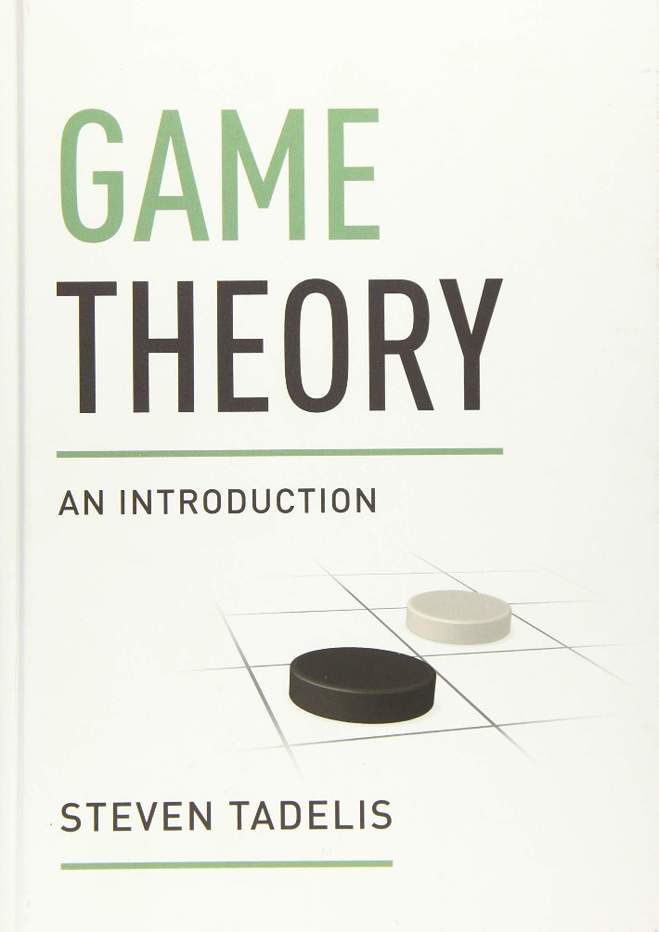
منابع درسی
Tadelis, Steven. Game theory: an introduction. Princeton university press, 2013.

Slide 3
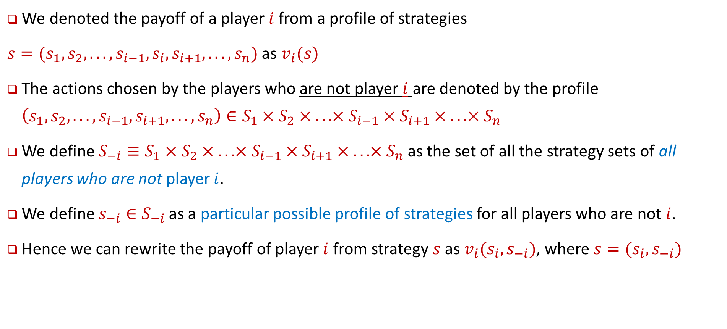
Common shorthand notations
We denoted the payoff of a player $i$ from a profile of strategies
$s=(s_{1}, s_{2}, . . . , s_{i−1}, s_{i}, s_{i+1}, . . . , s_{n})$ as $v_{i}(s)$
The actions chosen by the players who are not player $i$ are denoted by the profile $\left(s_{1}, s_{2}, . . . , s_{i−1}, s_{i+1}, . . . , s_{n}\right)∈S_{1}×S_{2}× . . . ×S_{i−1}×S_{i+1}× . . . ×S_{n}$
We define $S_{−i}≡S_{1}×S_{2}× . . . ×S_{i−1}×S_{i+1}× . . . ×S_{n}$as the set of all the strategy sets of all players who are not player $i$.
We define $s_{−i}∈S_{−i}$ as a particular possible profile of strategies for all players who are not $i$.
Hence we can rewrite the payoff of player $i$ from strategy $s$ as $v_{i}(s_{i}, s_{−i})$, where $s=(s_{i},s_{−i})$

Slide 4

Definition 4.1: Strictly Dominated Strategy
Let $s_{i}∈S_{i}$and ${s′}_{i}∈S_{i}$be possible strategies for player $i$.
We say that ${s′}_{i}$ is strictly dominated by $s_{i}$ if for any possible combination of the other players’ strategies,$s_{−i}∈S_{−i}$, player $i$’s payoff from ${s′}_{i}$ is strictly less than that from $s_{i}$ . That is, $v_{i}\left(s_{i}, s_{−i}\right)>v_{i}({s′}_{i}, s_{−i})$ for all $s_{−i}∈S_{−i}$.
We will write $s_{i}≻{s′}_{i}$ to denote that ${s′}_{i}$ is strictly dominated by $s_{i}$
Claim 4.1 A rational player will never play a strictly dominated strategy

Slide 5
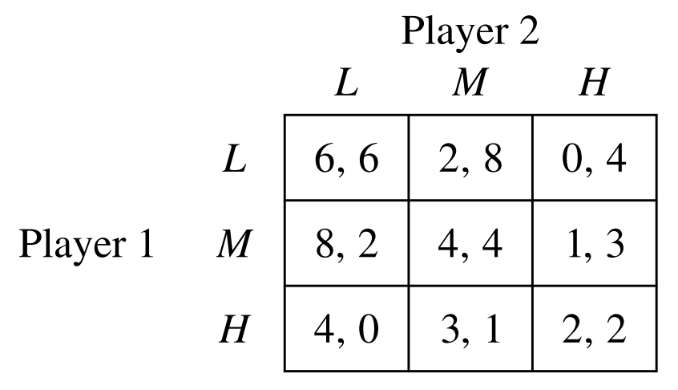
Example
Consider the following advertising game. Two competing brands can choose one of three marketing campaigns—low (L), medium (M), and high (H)—with payoffs given by the following matrix:
Each player has one dominated strategy, which is L.

Slide 6
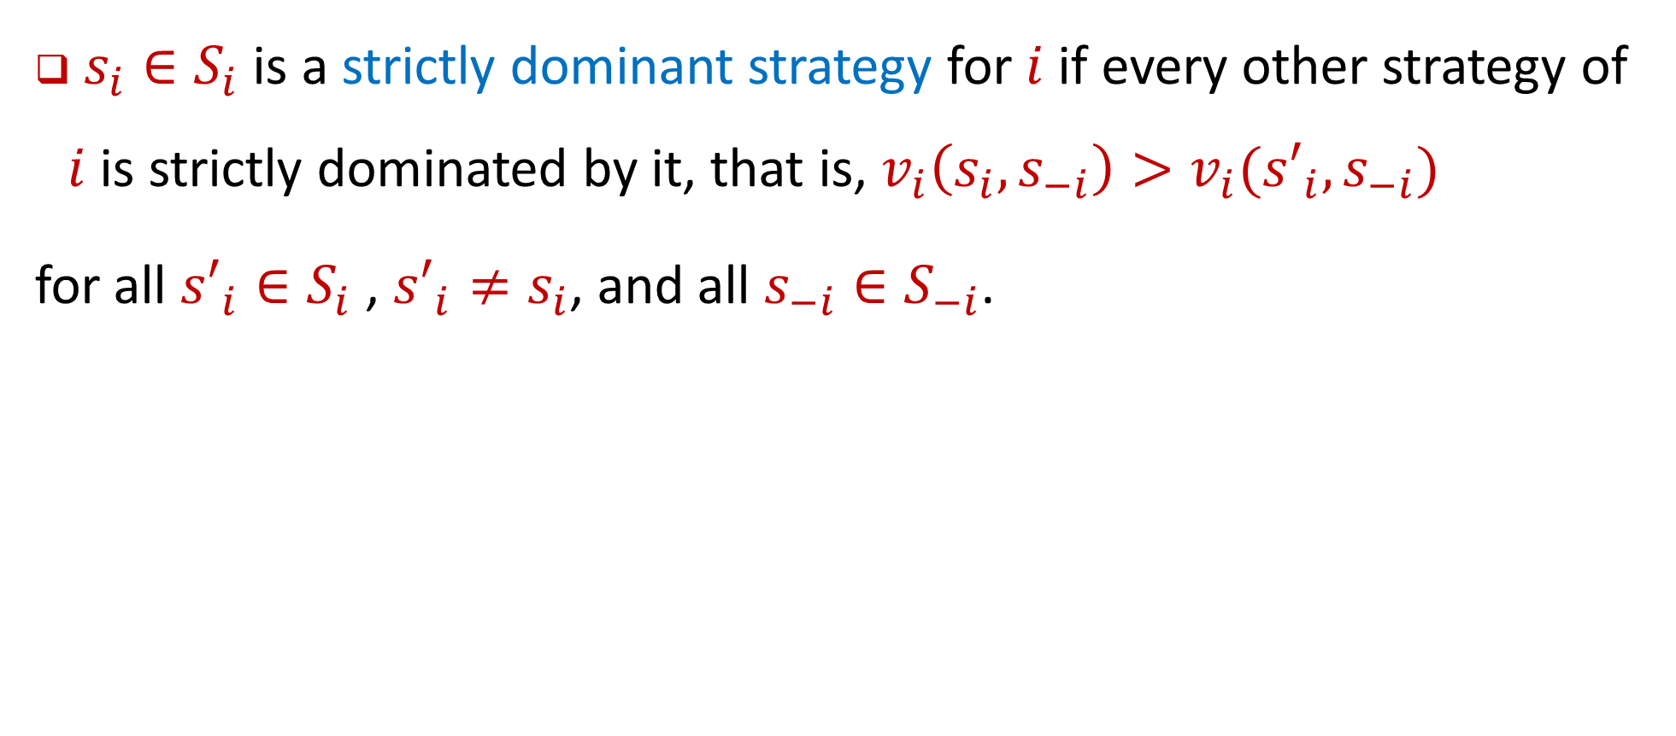
Definition 4.2: strictly dominant strategy
$s_{i}∈S_{i}$is a strictly dominant strategy for $i$ if every other strategy of $i$ is strictly dominated by it, that is, $v_{i}\left(s_{i}, s_{−i}\right)>v_{i}({s′}_{i}, s_{−i})$
for all ${s′}_{i}∈S_{i}$ , ${s′}_{i}≠s_{i}$, and all $s_{−i}∈S_{−i}$.

Slide 7
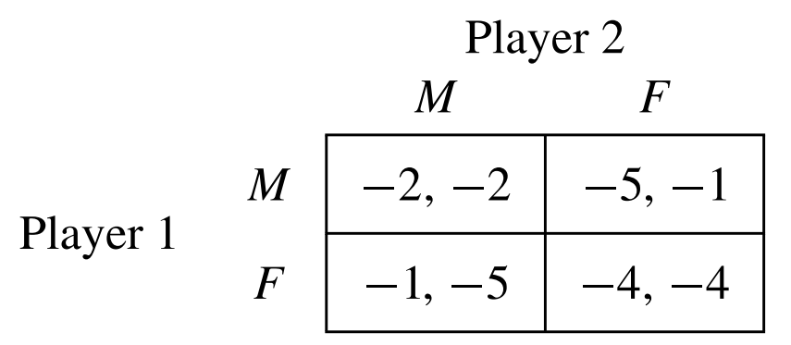
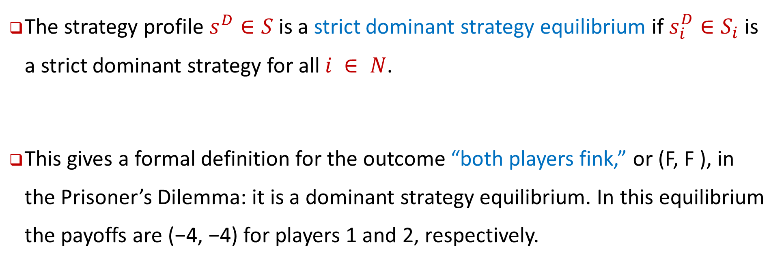
Definition 4.3: strict dominant strategy equilibrium
The strategy profile $s^{D}∈S$is a strict dominant strategy equilibrium if $s_{i}^{D}∈S_{i}$is a strict dominant strategy for all $i ∈ N$.
This gives a formal definition for the outcome “both players fink,” or (F, F ), in the Prisoner’s Dilemma: it is a dominant strategy equilibrium. In this equilibrium the payoffs are (−4, −4) for players 1 and 2, respectively.

Slide 8
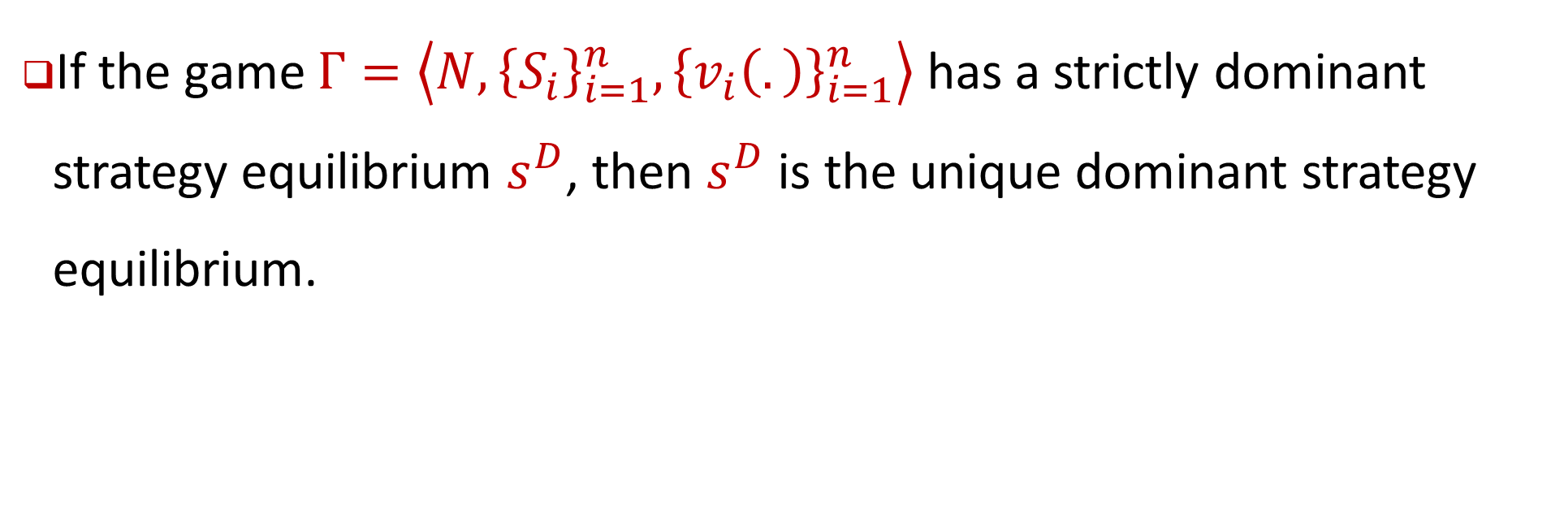
Proposition4.1
If the game $Γ=\left\langle N, {\left\{S_{i}\right\}}_{i=1}^{n}, {\left\{v_{i}\left(.\right)\right\}}_{i=1}^{n}\right\rangle$has a strictly dominant strategy equilibrium $s^{D}$, then $s^{D}$ is the unique dominant strategy equilibrium.

Slide 9
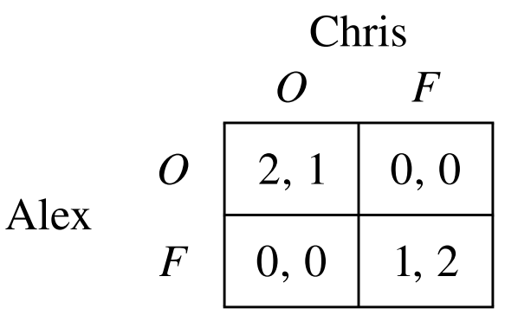
آیا همه مسائل را میتوان از این روش حل کرد
یک مشاهده به راحتی نشان میدهد که استفاده از شیوه dominant strategy equilibrium همیشه قابل انجام نیست.
بازی Battle of the Sexes را در نظر بگیرید:
هیچ یک از بازیکنان یک استراتژی غالب ندارند.
بهترین استراتژی برای کریس بستگی به انتخاب الکس دارد و بالعکس.
بنابراین، اگر به مفهوم راه‌حل strict-dominance solution پایبند باشیم، با بازی‌هایی مواجه می‌شویم که هیچ تعادلی برای آنها وجود نخواهد داشت.

Slide 10
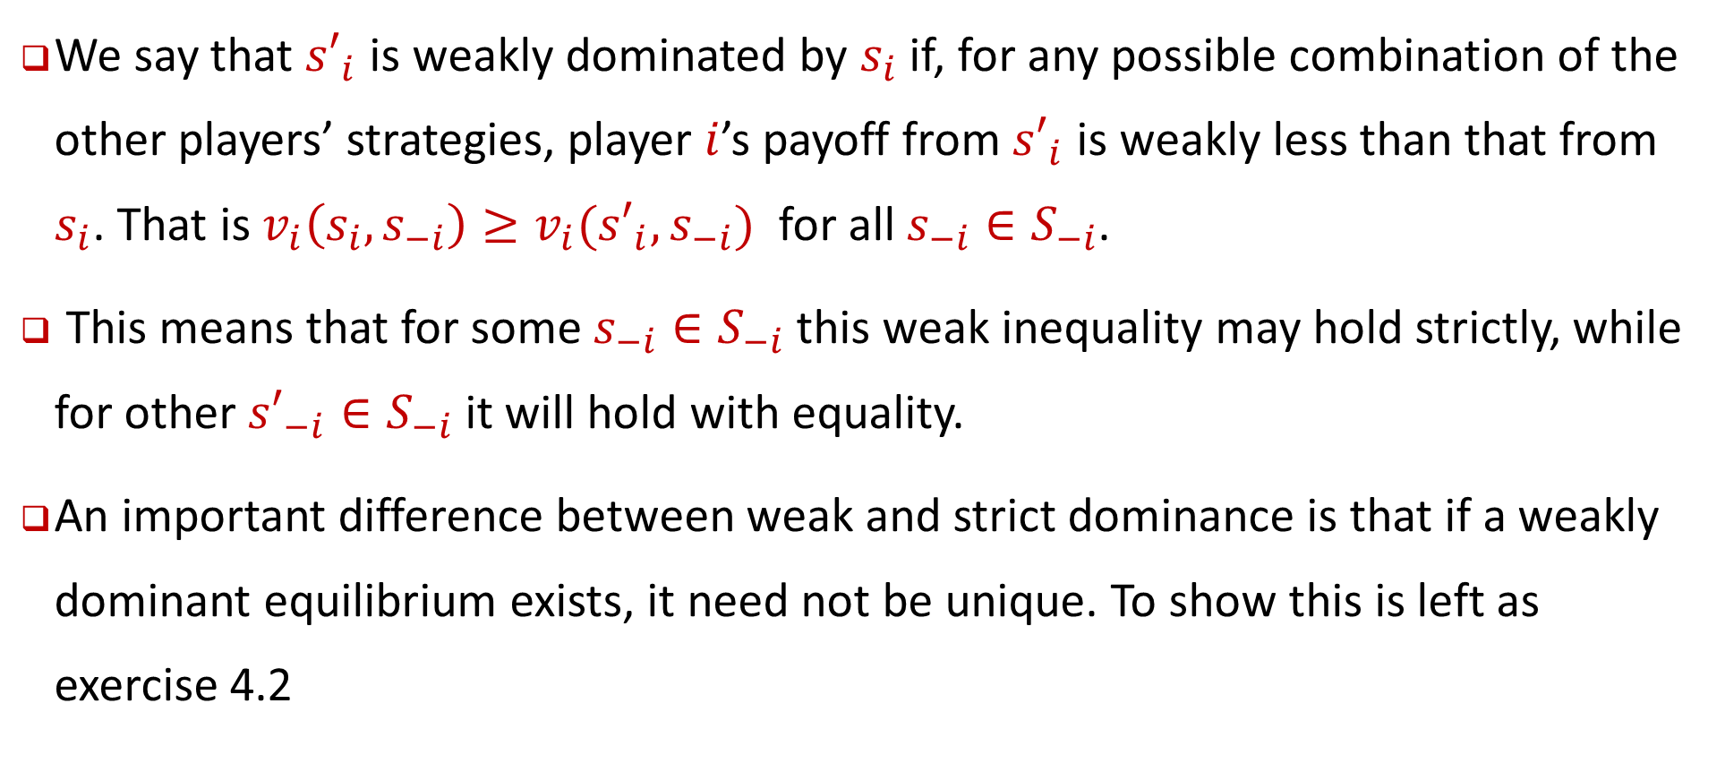
weak dominance
We say that ${s′}_{i}$ is weakly dominated by $s_{i}$ if, for any possible combination of the other players’ strategies, player $i$’s payoff from ${s′}_{i}$ is weakly less than that from $s_{i}$. That is $v_{i}\left(s_{i}, s_{−i}\right)≥v_{i}({s′}_{i}, s_{−i})$ for all $s_{−i}∈S_{−i}$.
This means that for some $s_{−i}∈S_{−i}$this weak inequality may hold strictly, while for other ${s′}_{−i}∈S_{−i}$ it will hold with equality.
An important difference between weak and strict dominance is that if a weakly dominant equilibrium exists, it need not be unique. To show this is left as exercise 4.2

Slide 11
important conclusions
1. A rational player will never play a dominated strategy.
2. If a rational player has a strictly dominant strategy then he will play it.

Slide 12
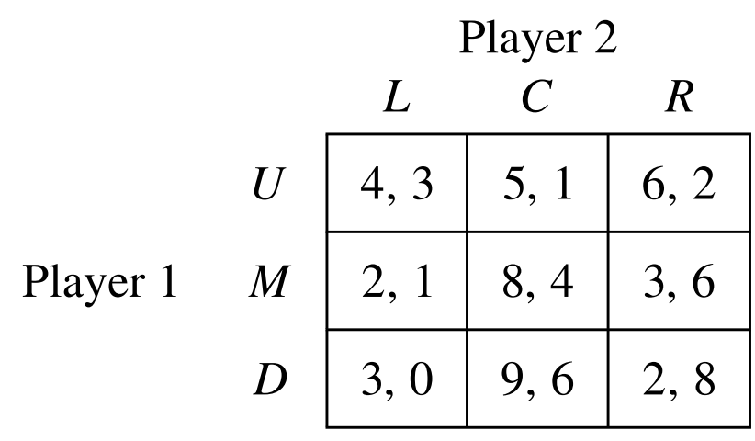
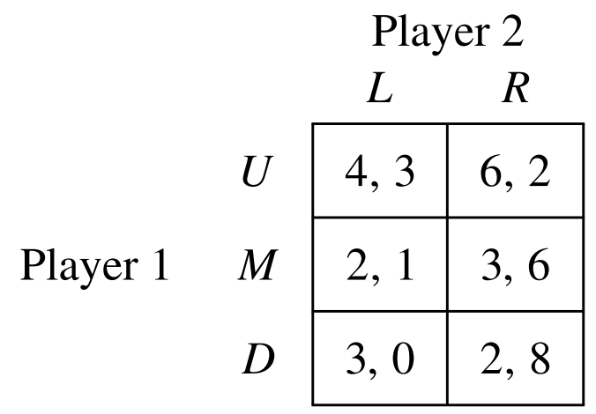
Iterated Elimination and Common Knowledge of Rationality
To see this idea more concretely, consider the following two-player finite game:
There is no strictly dominated strategy for player 1. There is, however, a strictly dominated strategy for player 2: the strategy C is strictly dominated by R because 2 > 1 (row U), 6 > 4 (row M), and 8 > 6 (row D).

Slide 13
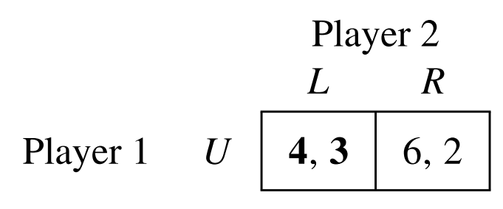
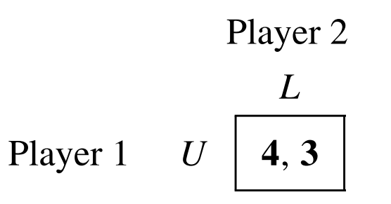
Iterated Elimination and Common Knowledge of Rationality
In this reduced game, both M and D are strictly dominated by U for player 1, allowing us to perform a second round of eliminating strategies, this time for player 1.
Eliminating these two strategies yields the following trivial game:
in which player 2 has a strictly dominated strategy, playing R.
Thus for this example the iterated process of eliminating dominated strategies yields a unique prediction: the strategy profile we expect these players to play is (U, L), giving the players the payoffs of (4, 3)

Slide 14
Iterated Elimination Of Strictly Dominated Strategies (IESDS)
Step 1:
Step 2:
Step 3:
Step 4:
Define $S_{i}^{0} = S_{i}$for each $i$, the original strategy set of player $i$ in the game, and set $k=0$.
Define 𝑆_𝑖^0 = 𝑆_𝑖 for each 𝑖, the original strategy set of player 𝑖 in the game, and set 𝑘=0.
Are there players for whom there are strategies $s_{i}∈S_{i}^{k}$that are strictly dominated? If yes, go to step 3. If not, go to step 4.
Are there players for whom there are strategies 𝑠_𝑖∈𝑆_𝑖^𝑘 that are strictly dominated? If yes, go to step 3. If not, go to step 4.
For all the players $i∈N$, remove any strategies $s_{i}∈S_{i}^{k}$ that are strictly dominated. Set $k=k+1$, and define a new game with strategy sets $S_{i}^{k}$ that do not include the strictly dominated strategies that have been removed. Go back to step 2.
For all the players 𝑖∈𝑁, remove any strategies 𝑠_𝑖∈𝑆_𝑖^𝑘 that are strictly dominated. Set 𝑘=𝑘+1, and define a new game with strategy sets 𝑆_𝑖^𝑘 that do not include the strictly dominated strategies that have been removed. Go back to step 2.
The remaining strategies in $S_{i}^{k}$ are reasonable predictions for behavior.
The remaining strategies in 𝑆_𝑖^𝑘 are reasonable predictions for behavior.

Slide 15
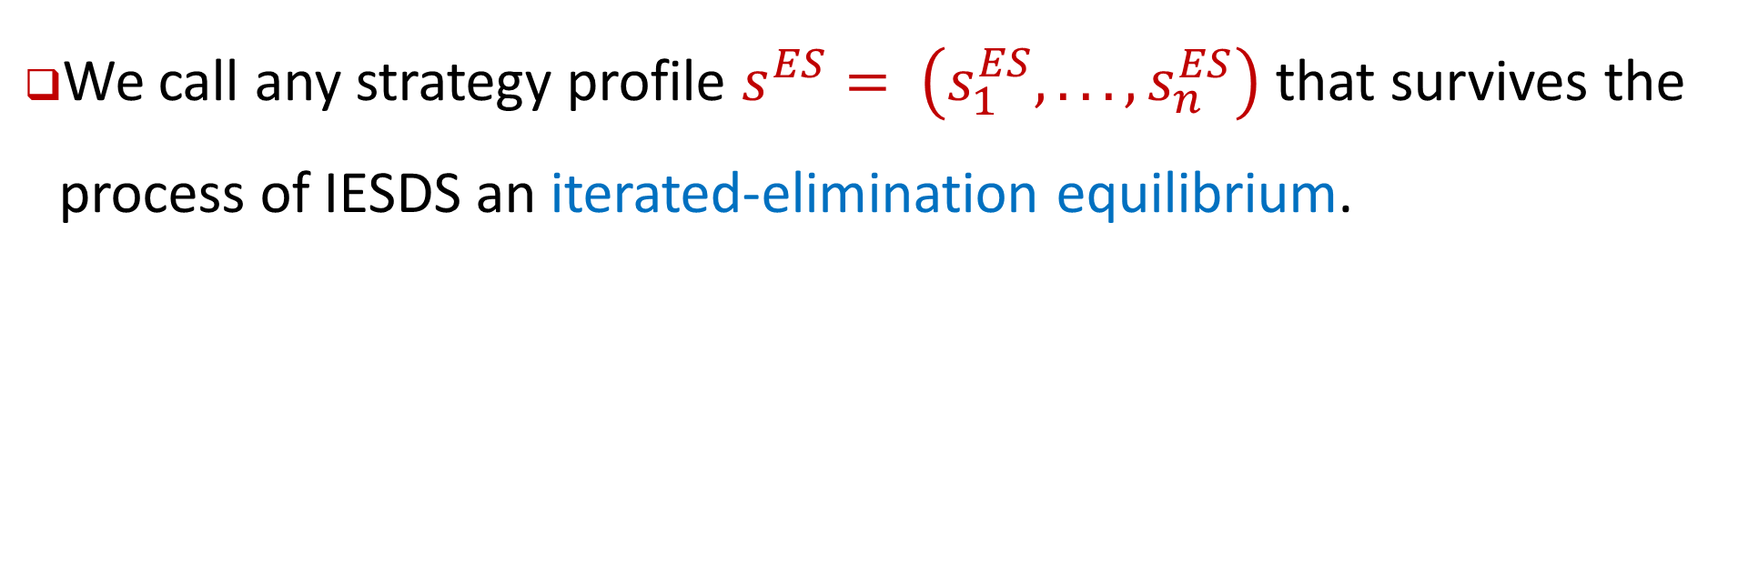
Definition 4.4: iterated-elimination equilibrium
We call any strategy profile $s^{ES}= \left(s_{1}^{ES}, . . . ,s_{n}^{ES}\right)$that survives the process of IESDS an iterated-elimination equilibrium.

Slide 16
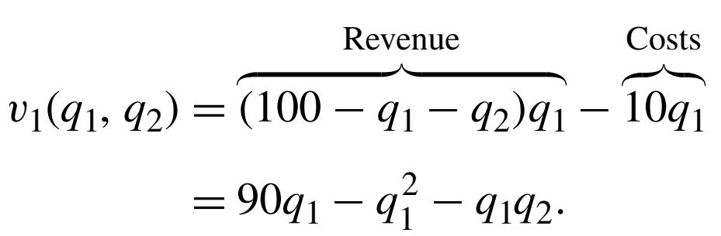
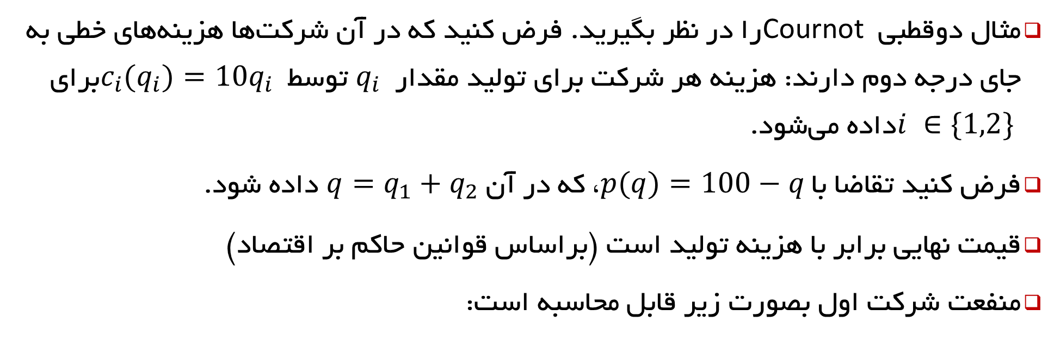
Example: Cournot Duopoly
مثال دوقطبی Cournot را در نظر بگیرید. فرض کنید که در آن شرکت‌ها هزینه‌های خطی به جای درجه دوم دارند: هزینه هر شرکت برای تولید مقدار $q_{i}$ توسط $c_{i}(q_{i})=10q_{i}$ برای $i ∈\{1,2\}$داده می‌شود.
فرض کنید تقاضا با $p(q)=100−q$، که در آن $q=q_{1}+q_{2}$ داده شود.
قیمت نهایی برابر با هزینه تولید است (براساس قوانین حاکم بر اقتصاد)
منفعت شرکت اول بصورت زیر قابل محاسبه است:

Slide 17
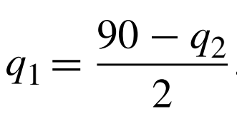
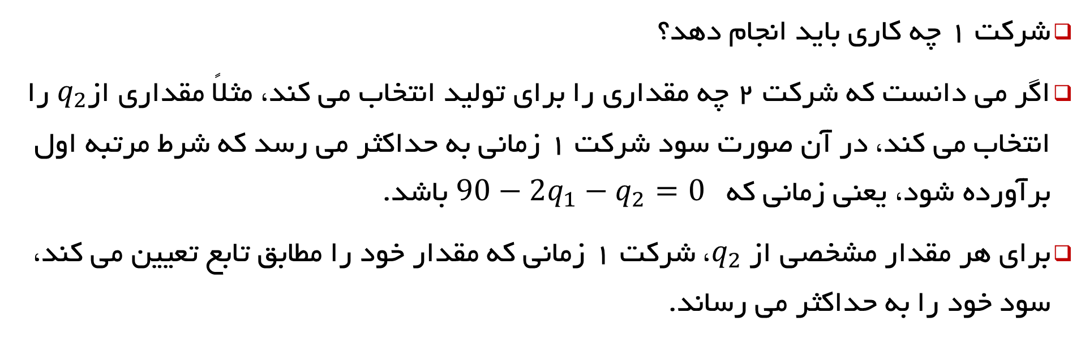
Example: Cournot Duopoly(2)
شرکت 1 چه کاری باید انجام دهد؟
اگر می دانست که شرکت 2 چه مقداری را برای تولید انتخاب می کند، مثلاً مقداری از$q_{2}$ را انتخاب می کند، در آن صورت سود شرکت 1 زمانی به حداکثر می رسد که شرط مرتبه اول برآورده شود، یعنی زمانی که $90−2q_{1}−q_{2}=0$ باشد.
برای هر مقدار مشخصی از $q_{2}$، شرکت 1 زمانی که مقدار خود را مطابق تابع تعیین می کند، سود خود را به حداکثر می رساند.

Slide 18
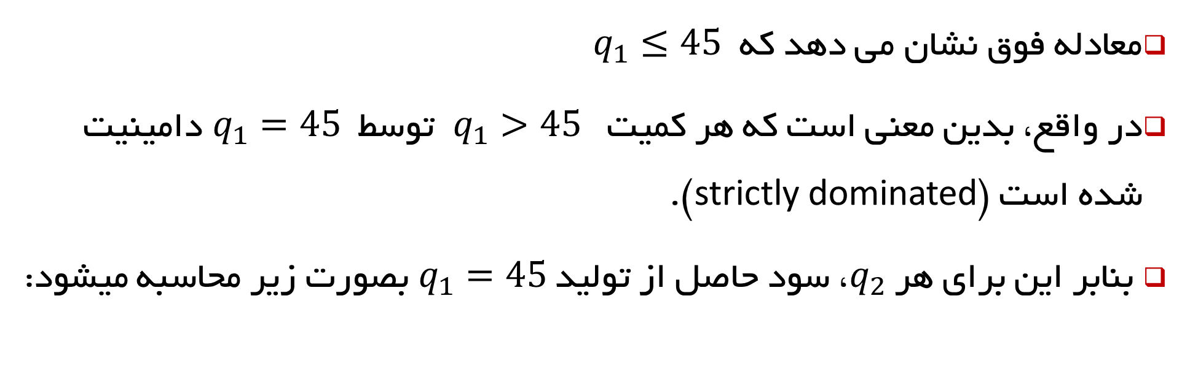
Example: Cournot Duopoly(2)
معادله فوق نشان می دهد که $q_{1}≤45$
در واقع، بدین معنی است که هر کمیت $q_{1}>45$ توسط $q_{1}=45$ دامینیت شده است (strictly dominated).
بنابر این برای هر $q_{2}$، سود حاصل از تولید $q_{1}=45$ بصورت زیر محاسبه میشود:

Slide 19
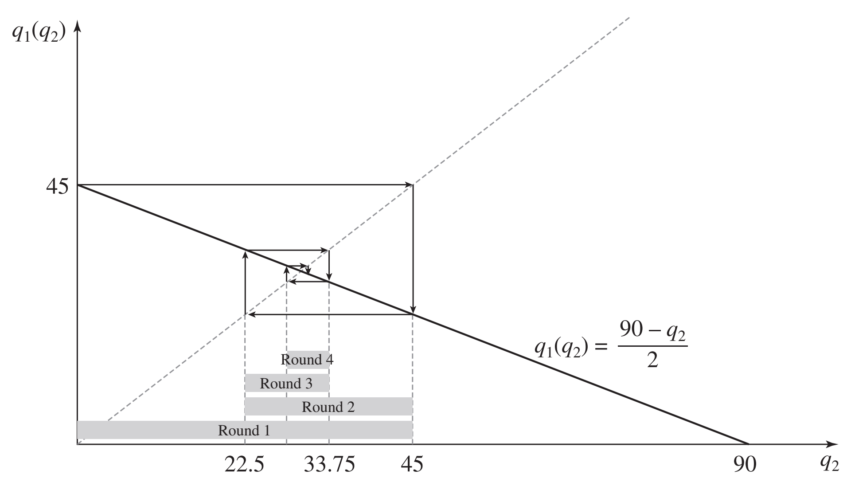
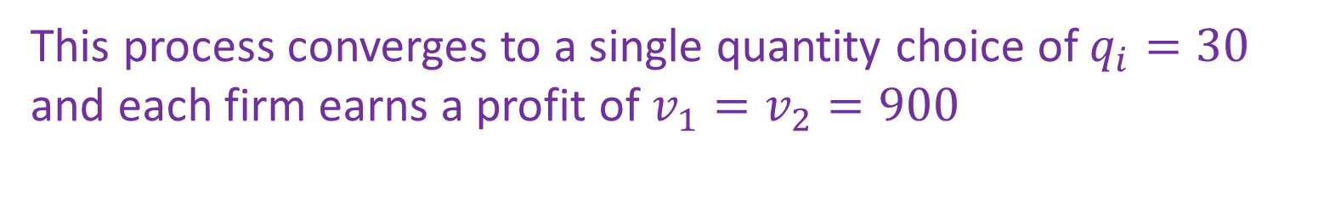
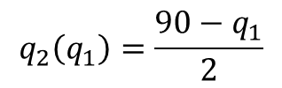
Example: Cournot Duopoly(3)
This process converges to a single quantity choice of $q_{i}=30$
and each firm earns a profit of $v_{1}=v_{2}=900$
$$q_{2}\left(q_{1}\right)=\frac{90−q_{1}}{2}$$

Slide 20
Iterated Elimination Of Strictly Dominated Strategies (IESDS)
علیرغم کارایی خوب روش IESDS متاسفانه این روش برای بسیاری از بازی ها جواب نمیدهد.
البته استفاده از این روش ممکن است حالات ممکن بازی را کاهش دهد

Slide 21
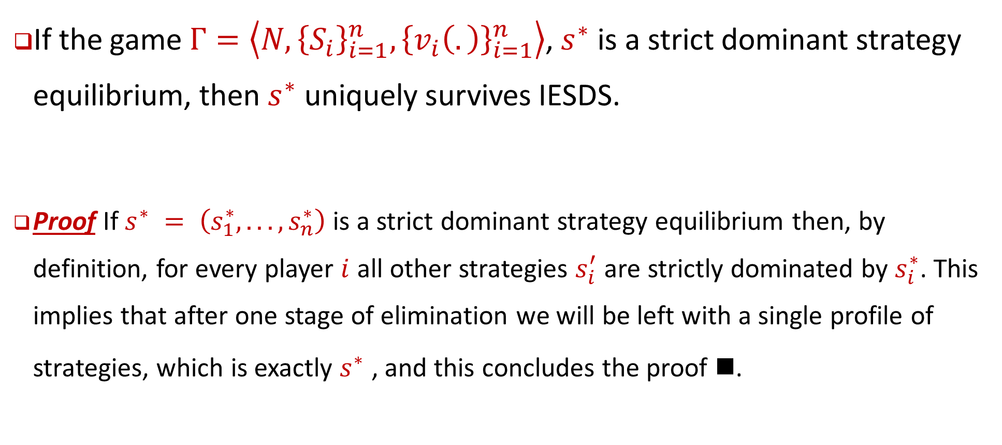
Proposition 4.2
If the game $Γ=\left\langle N, {\left\{S_{i}\right\}}_{i=1}^{n}, {\left\{v_{i}\left(.\right)\right\}}_{i=1}^{n}\right\rangle$, $s^{∗}$ is a strict dominant strategy equilibrium, then $s^{∗}$ uniquely survives IESDS.
Proof If $s^{∗} = \left(s_{1}^{∗}, . . . ,s_{n}^{∗}\right)$ is a strict dominant strategy equilibrium then, by definition, for every player $i$ all other strategies $s_{i}^{′}$ are strictly dominated by $s_{i}^{∗}$. This implies that after one stage of elimination we will be left with a single profile of strategies, which is exactly $s^{∗}$ , and this concludes the proof .

Slide 22
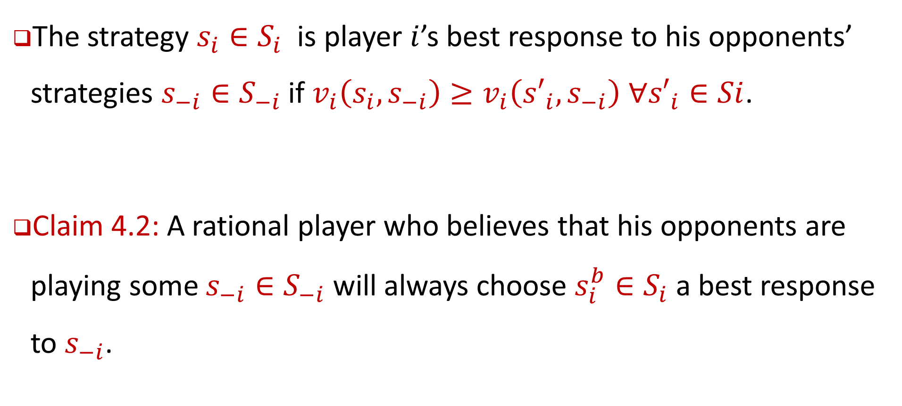
Definition 4.5: Best Response
The strategy ${s_{i}∈S}_{i}$ is player $i$’s best response to his opponents’ strategies ${s_{−i}∈S}_{−i}$ if $v_{i}\left(s_{i}, s_{−i}\right)≥v_{i}\left({s′}_{i}, s_{−i}\right) ∀{s′}_{i}∈Si$.
Claim 4.2: A rational player who believes that his opponents are playing some ${s_{−i}∈S}_{−i}$ will always choose ${s_{i}^{b}∈S}_{i}$ a best response to $s_{−i}$.

Slide 23
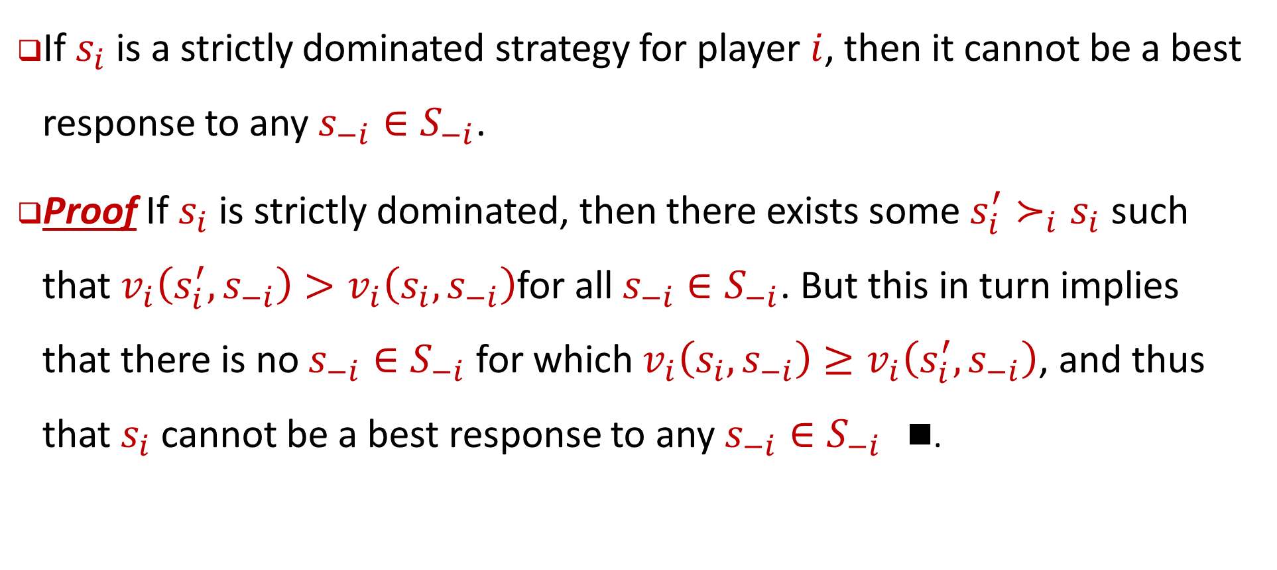
Proposition 4.3
If $s_{i}$ is a strictly dominated strategy for player $i$, then it cannot be a best response to any ${s_{−i}∈S}_{−i}$.
Proof If $s_{i}$ is strictly dominated, then there exists some $s_{i}^{′}≻_{i}s_{i}$ such that $v_{i}\left(s_{i}^{′}, s_{−i}\right)>v_{i}\left(s_{i}, s_{−i}\right)$for all $s_{−i}∈S_{−i}$. But this in turn implies that there is no $s_{−i}∈S_{−i}$ for which $v_{i}\left(s_{i}, s_{−i}\right)≥v_{i}\left(s_{i}^{′}, s_{−i}\right)$, and thus that $s_{i}$ cannot be a best response to any ${s_{−i}∈S}_{−i}$ .

Slide 24
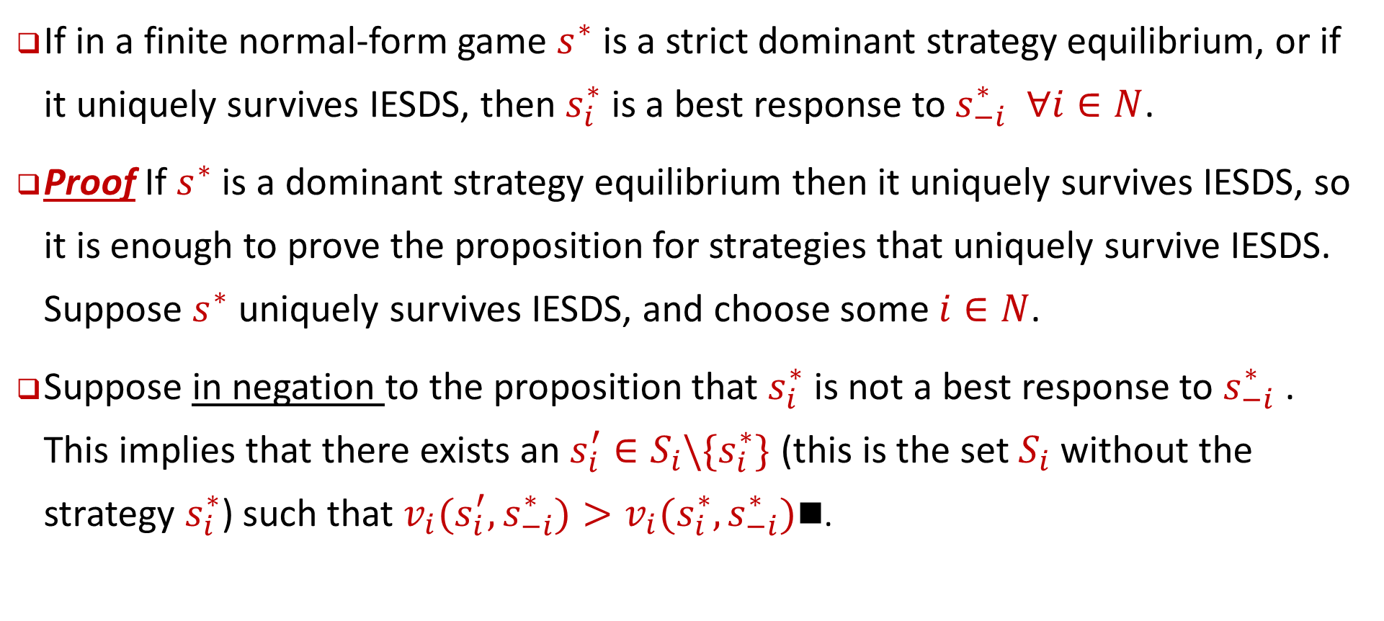
Proposition 4.4
If in a finite normal-form game $s^{∗}$ is a strict dominant strategy equilibrium, or if it uniquely survives IESDS, then $s_{i}^{∗}$ is a best response to $s_{−i}^{∗}$ $∀i∈N$.
Proof If $s^{∗}$ is a dominant strategy equilibrium then it uniquely survives IESDS, so it is enough to prove the proposition for strategies that uniquely survive IESDS. Suppose $s^{∗}$ uniquely survives IESDS, and choose some $i∈N$.
Suppose in negation to the proposition that $s_{i}^{∗}$ is not a best response to $s_{−i}^{∗}$ . This implies that there exists an $s_{i}^{′}∈S_{i}\backslash \{s_{i}^{∗}\}$ (this is the set $S_{i}$ without the strategy $s_{i}^{∗}$) such that $v_{i}(s_{i}^{′}, s_{−i}^{∗})>v_{i}(s_{i}^{∗}, s_{−i}^{∗})$.

Slide 25
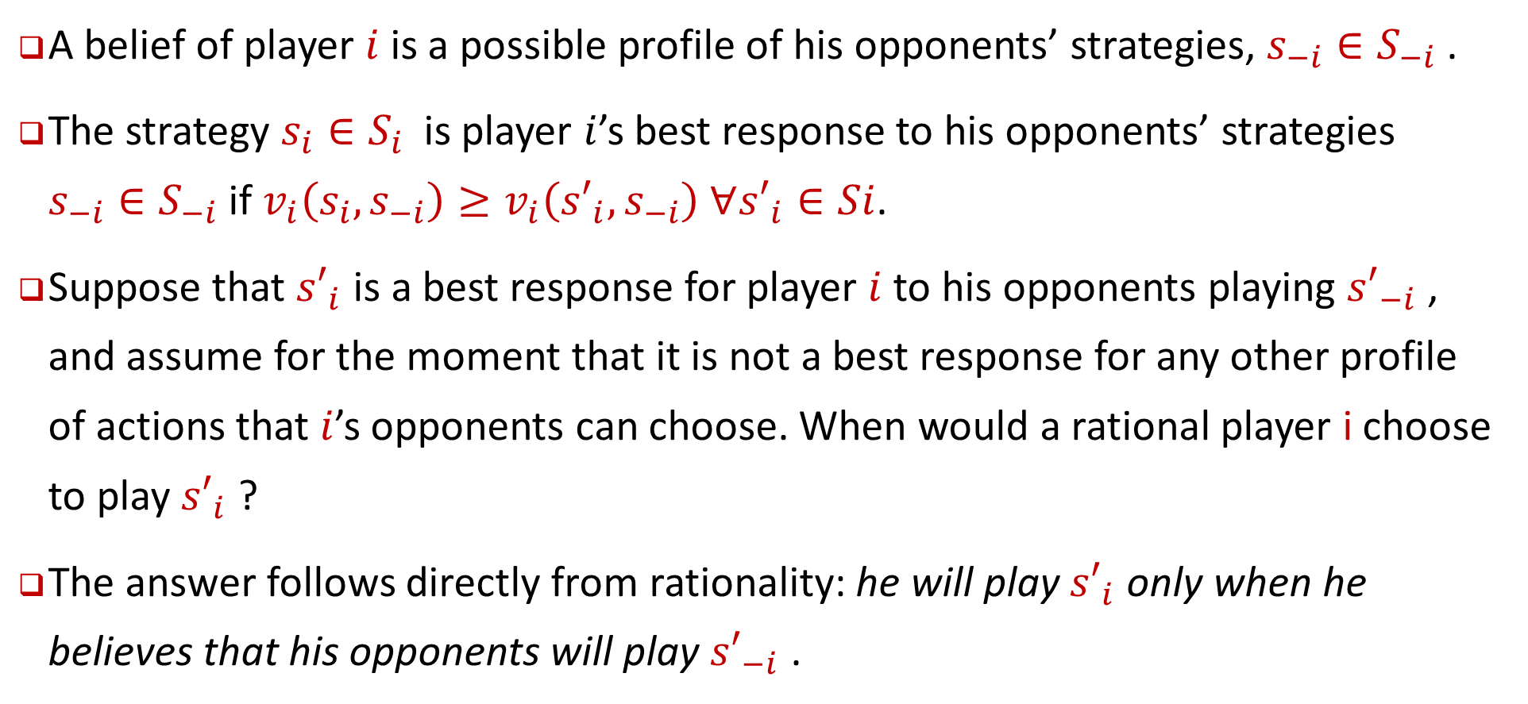
Definition 4.6: Belief of Player
A belief of player $i$ is a possible profile of his opponents’ strategies, ${s_{−i}∈S}_{−i}$.
The strategy ${s_{i}∈S}_{i}$ is player $i$’s best response to his opponents’ strategies ${s_{−i}∈S}_{−i}$ if $v_{i}\left(s_{i}, s_{−i}\right)≥v_{i}\left({s′}_{i}, s_{−i}\right) ∀{s′}_{i}∈Si$.
Suppose that ${s′}_{i}$ is a best response for player $i$to his opponents playing ${s′}_{−i}$ , and assume for the moment that it is not a best response for any other profile of actions that $i$’s opponents can choose. When would a rational player i choose to play ${s′}_{i}$ ?
The answer follows directly from rationality: he will play ${s′}_{i}$ only when he believes that his opponents will play ${s′}_{−i}$ .

Slide 26
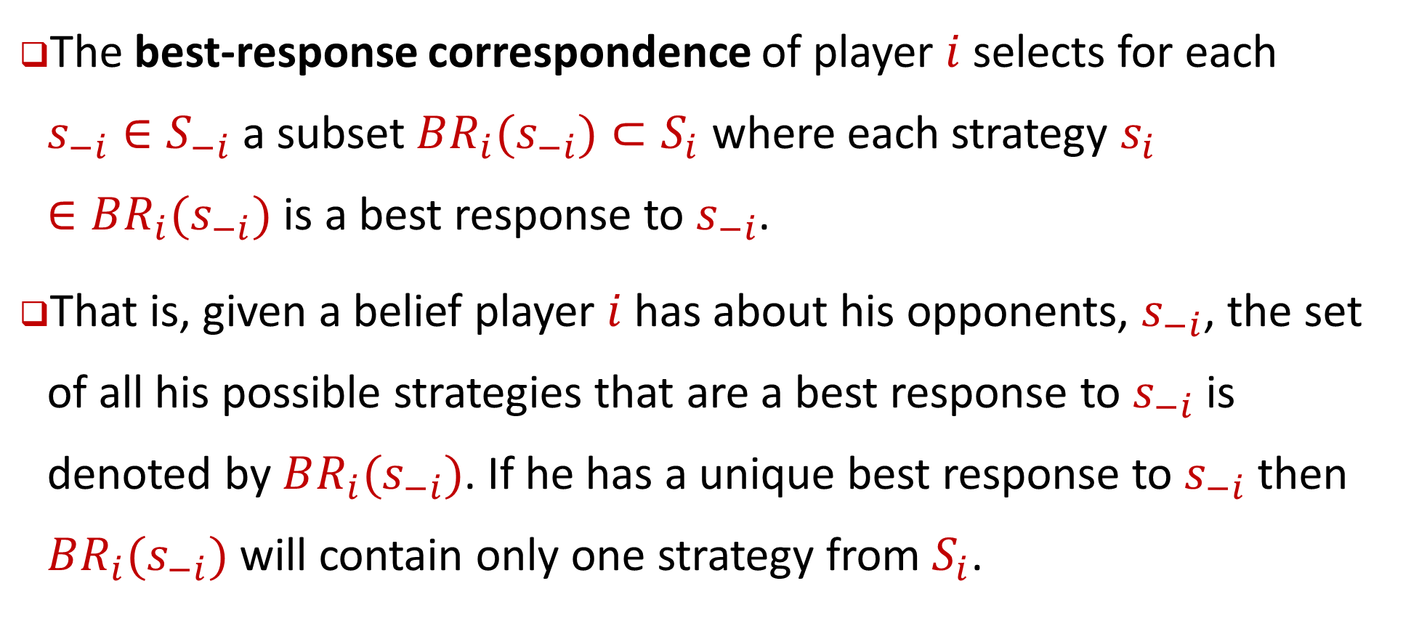
Definition 4.7: best-response correspondence
The best-response correspondence of player $i$ selects for each ${s_{−i}∈S}_{−i}$a subset $BR_{i}(s_{−i})⊂S_{i}$ where each strategy $s_{i}∈BR_{i}(s_{−i})$ is a best response to $s_{−i}$.
That is, given a belief player $i$ has about his opponents, $s_{−i}$, the set of all his possible strategies that are a best response to $s_{−i}$ is denoted by $BR_{i}(s_{−i})$. If he has a unique best response to $s_{−i}$ then $BR_{i}(s_{−i})$ will contain only one strategy from $S_{i}$.

Slide 27
تمرینات
از 10 تمرین (10 بازی) آورده شده در پایان فصل چهارم کتاب (صفحه 76)، 5 مورد را به انتخاب خود، حل و در سامانه بارگزاری نمایید

Slide 28
Summary
Rational players will never play a dominated strategy and will always play a dominant strategy when it exists.
When players share common knowledge of rationality, the only strategies that are sensible are those that survive IESDS (Iterated Elimination Of Strictly Dominated Strategies).
Rational players will always play a best response to their beliefs. Hence any strategy for which there are no beliefs that justify its choice will never be chosen.

Slide 29
End of Chapter 4

