Slide 1


معماری کامپیوتر پیشرفته
فصل دوم
Memory Hierarchy Design
وحید حقیقت دوست
haghighatdoost@shahed.ac.ir
http://ref.shahed.ac.ir/haghighatdoost
دانشکده فنی و مهندسی

Slide 2
Computer Architecture
A Quantitative Approach, Sixth Edition
Chapter 2
Memory Hierarchy Design
Hohn L. Hennessy
David A. Patterson

Slide 3
Cache Basics
n sets => k-way set associative
  Direct-mapped cache => one block per set
  Fully associative => one set
Writing to cache: two strategies
  Write-through
    Immediately update lower levels of hierarchy (فورا سطوح پایین تر سلسله مراتب به روز میشود)
  Write-back
    Only update lower levels of hierarchy when an updated block is replaced (فقط زمانی که یک بلوک به روز شده جایگزین شود، سطوح پایین تر سلسله مراتب به روز میشود)
  Both strategies use write buffer to make writes asynchronous
Notes:
طبق آنچه که از RAM میشناسیم، داده ها در بلوک های 32 بایتی و یا 64 بایتی باشد.
حافظه RAM را به بلوک ها تقسیم میکنیم.
نگاشت بلوک های حافظه به بلوک های کش سه حالت را بوجود می آورد.
بلوک های کش را مجموعه بندی میکنیم که باتوجه به تعداد مجموعه ها و تعداد بلوکهای موجود درمجموعه ها حالات زیر ایجاد میشود:
1- اگر هر مجموعه (Set) فقط یک بلاک داشته باشد -> Direct-mapped یا نگاشت مستقیم
2- اگر تنها یک مجموعه برای کش در نظر گرفته شود-> Fully Associative یا کاملاً شرکت پذیر
3- در غیر اینصورت k-way set associative شرکت پذیر k راهه

Slide 4
Simplest Cache: Direct Mapped
0
4 Byte Direct Mapped Cache
1
Cache Index
2
0
3
1
4
2
5
3
6
7
Location 0 can be occupied by data from:
  Memory location 0, 4, 8, ... etc.
  In general: any memory location
  whose 2 LSBs of the address are 0s.
  Address<1:0> => cache index.
Which one should we place in the cache?
How can we tell which one is in the cache?
8
9
A
B
C
D
E
F
Notes:
Let’s look at the simplest cache one can build. A direct mapped cache that only has 4 bytes.
In this direct mapped cache with only 4 bytes, location 0 of the cache can be occupied by data form memory location 0, 4, 8, C, ... and so on.
While location 1 of the cache can be occupied by data from memory location 1, 5, 9, ... etc.
So in general, the cache location where a memory location can map to is uniquely determined by the 2 least significant bits of the address (Cache Index).
For example here, any memory location whose two least significant bits of the address are 0s can go to cache location zero.
With so many memory locations to chose from, which one should we place in the cache?
Of course, the one we have read or write most recently because by the principle of temporal locality, the one we just touch is most likely to be the one we will need again soon.
Of all the possible memory locations that can be placed in cache Location 0, how can we tell which one is in the cache?
+2 = 22 min. (Y:02)

Slide 5


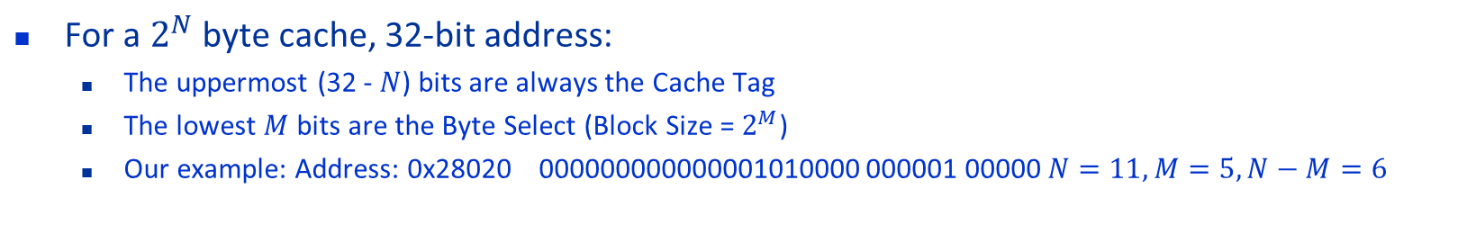
2 KB Direct Mapped Cache, 32B blocks
For a $2^{N}$ byte cache, 32-bit address:
  The uppermost (32 - $N$) bits are always the Cache Tag
  The lowest $M$ bits are the Byte Select (Block Size = $2^{M}$)
  Our example: Address: 0x28020 000000000000001010000 000001 00000 $N=11, M=5, N−M=6$
$N$ : ظرفیت کش
$M$ : ظرفیت هر بلوک
31
10
4
0
Cache Tag
Example: 0x50
Cache(Block) Index
Byte Select(offset)
Ex: 0x01
Ex: 0x00
Stored as part
of the cache “state”
Valid Bit
Cache Tag
Cache Data
Byte 31
:
Byte 1
Byte 0
0
0x50
Byte 63
:
Byte 33
Byte 32
1
2
3
:
:
:
Byte 2047
:
Byte 2016
63
Notes:
Let’s use a specific example with realistic numbers: assume we have a 1 KB direct mapped cache with block size equals to 32 bytes.
In other words, each block associated with the cache tag will have 32 bytes in it (Row 1).
With Block Size equals to 32 bytes, the 5 least significant bits of the address will be used as byte select within the cache block.
Since the cache size is 1K byte, the upper 32 minus 10 bits, or 22 bits of the address will be stored as cache tag.
The rest of the address bits in the middle, that is bit 5 through 9, will be used as Cache Index to select the proper cache entry.
+2 = 30 min. (Y:10)

Slide 6
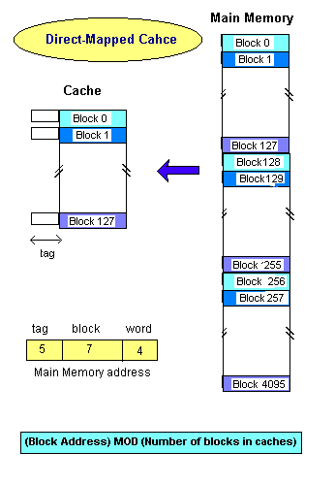
Direct Mapped Cache
Advantage.
Simple hardware decision for replacement
Low cost.
It doesn't need replacement algorithm.
Disadvantage:
See example.

Slide 7
Example
قطعه کد زیر را در نظر بگیرید. در این برنامه بطور متناوب دو متغیر مورد استفاده قرار میگیرند که فاصله آنها از هم 128 بلاک است.
مشکل Direct map در این است که ممکن است ما روی برخی از بلاک ها تنازع داشته باشیم، در حالی که دیگر بلاک ها بیکار هستند.
Repeat.
Call get data ; compiled in block x of memory.
Call compare ; compiled in block x+128 of memory.
Until match or end_of_data.
___________________________________________.
Both blocks must be mapped to block x of cache, so miss will occur whenever the repeat-until loop executes.

Slide 8
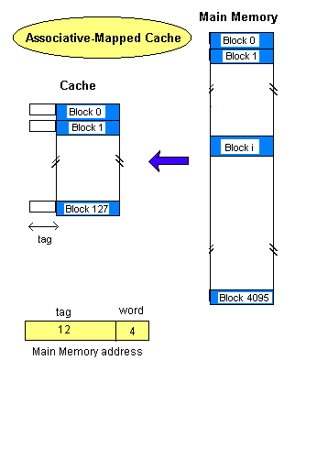
Fully Associative
FULLY_ASSOCIATIVE.
Advantages:
NO limitation in block mapping.
Possibility of using different replacement algorithms.
NO relation between the number of memory blocks and cache blocks.
Disadvantage:
Higher cost, because of the need to search of all tags.

Slide 9
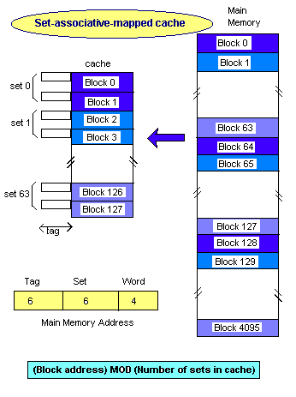
Set Associative
Combination of direct and associative mapping techniques.
The contention problem of direct method is eased.
The hardware cost is reduced by decreasing the size of associative search.

Slide 10
Two-way Set Associative Cache
N-way set associative: N entries for each Cache Index
  N direct mapped caches operates in parallel (N typically 2 to 4)
Example: Two-way set associative cache
  Cache Index selects a “set” from the cache
  The two tags in the set are compared in parallel
  Data is selected based on the tag result
Cache Index
Valid
Cache Tag
Cache Data
Cache Data
Cache Tag
Valid
Cache Block 0
Cache Block 0
:
:
:
:
:
:
Adr Tag
Adr Tag
Compare
Sel1
1
Mux
0
Sel0
Compare
OR
Cache Block
Hit
Notes:
This is called a 2-way set associative cache because there are two cache entries for each cache index. Essentially, you have two direct mapped cache works in parallel.
This is how it works: the cache index selects a set from the cache. The two tags in the set are compared in parallel with the upper bits of the memory address.
If neither tag matches the incoming address tag, we have a cache miss.
Otherwise, we have a cache hit and we will select the data on the side where the tag matches occur.
This is simple enough. What is its disadvantages?
+1 = 36 min. (Y:16)

Slide 11
Disadvantage of Set Associative Cache
N-way Set Associative Cache v. Direct Mapped Cache:
  N comparators vs. 1.
  Extra MUX delay for the data.
  Data comes AFTER Hit/Miss.
In a direct mapped cache, Cache Block is available BEFORE Hit/Miss:
  Possible to assume a hit and continue. Recover later if miss.
Cache Index
Valid
Cache Tag
Cache Data
Cache Data
Cache Tag
Valid
Cache Block 0
Cache Block 0
:
:
:
:
:
:
Adr Tag
Compare
Sel1
1
Mux
0
Sel0
Compare
OR
Cache Block
Hit
Notes:
First of all, a N-way set associative cache will need N comparators instead of just one comparator (use the right side of the diagram for direct mapped cache).
A N-way set associative cache will also be slower than a direct mapped cache because of this extra multiplexer delay.
Finally, for a N-way set associative cache, the data will be available AFTER the hit/miss signal becomes valid because the hit/mis is needed to control the data MUX.
For a direct mapped cache, that is everything before the MUX on the right or left side, the cache block will be available BEFORE the hit/miss signal (AND gate output) because the data does not have to go through the comparator.
This can be an important consideration because the processor can now go ahead and use the data without knowing if it is a Hit or Miss. Just assume it is a hit.
Since cache hit rate is in the upper 90% range, you will be ahead of the game 90% of the time and for those 10% of the time that you are wrong, just make sure you can recover.
You cannot play this speculation game with a N-way set-associatvie cache because as I said earlier, the data will not be available to you until the hit/miss signal is valid.
+2 = 38 min. (Y:18)

Slide 12
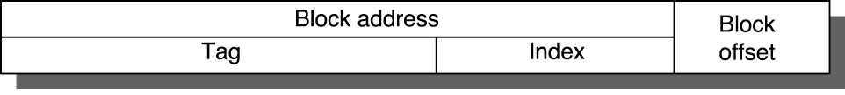
Cache Size Equation
Simple equation for the size of a cache:
  (Cache size) = (Block size) × (Number of sets)
  × (Set Associativity)
Can relate to the size of various address fields:
  (Block size) = 2^{(# of offset bits)}
  (Number of sets) = 2^{(# of index bits)}
  (# of tag bits) = (# of memory address bits)
  − (# of index bits) − (# of offset bits)

Slide 13
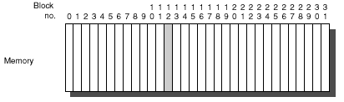
Q1: Where can a block be placed in the upper level?
Block 12 placed in 8-block cache:
  Fully associative, direct mapped, 2-way set associative
  S.A. Mapping = Block Number Modulo Number Sets (n-way set associative)

Slide 14

Q2: How is a block found if it is in the upper level?
Tag on each block
  No need to check index or block offset
Increasing associativity →
  shrinks index →
    expands tag

Slide 15
Q3: Which block should be replaced on a miss?
Easy for Direct Mapped
Set Associative or Fully Associative:
  Random
  LRU (Least Recently Used)
    Block that has been unused for the longest time.
  FIFO (First In First Out)
  LFU (Least Frequently used)

