Slide 1


معماری کامپیوتر پیشرفته
فصل سوم
Instruction-Level Parallelism and Its Exploitation
Multiple Issue and Static Scheduling
وحید حقیقت دوست
haghighatdoost@shahed.ac.ir
http://ref.shahed.ac.ir/haghighatdoost
دانشکده فنی و مهندسی

Slide 2
Copyright Notice
Lectures adopted from
Computer Architecture: A Quantitative Approach, 6th edition, John L. Hennessy,‎ David A. Patterson, MK pub., 2019

Slide 3
Computer Architecture
A Quantitative Approach, Sixth Edition
Chapter 3
Instruction-Level Parallelism and Its Exploitation

Slide 4
Multiple Issue and Static Scheduling
To achieve CPI < 1, need to complete multiple instructions per clock
Solutions:
Statically scheduled superscalar processors
VLIW (very long instruction word) processors
Dynamically scheduled superscalar processors
با همه تلاشی که در مباحث گذشته انجام دادیم، توانستیم کاری کنیم که CPI به یک نزدیک شود.
میخواهیم ساز و کاری را مطالعه کنیم که ما را به CPI<1 برساند.
یعنی در هر کلاک بیش از یک Instruction اجرا شود.

Slide 5
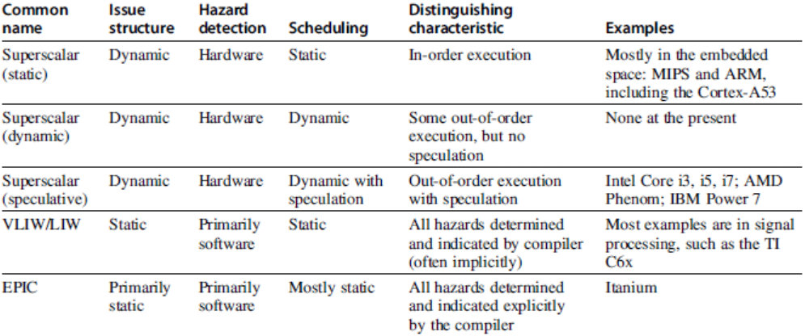
Multiple Issue

Slide 6
VLIW Processors
Package multiple operations into one instruction
Example VLIW processor:
One integer instruction (or branch)
Two independent floating-point operations
Two independent memory references
Must be enough parallelism in code to fill the available slots

Slide 7
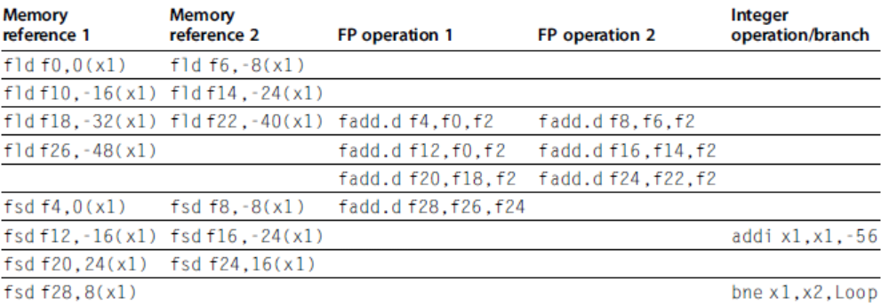
VLIW (very long instruction word) Processors
Disadvantages:
Statically finding parallelism
Code size
No hazard detection hardware
Binary code compatibility

Slide 8
Dynamic Scheduling, Multiple Issue, and Speculation
Modern microarchitectures:
Dynamic scheduling + multiple issue + speculation
Two approaches:
Assign reservation stations and update pipeline control table in half clock cycles
Only supports 2 instructions/clock
Design logic to handle any possible dependencies between the instructions
Issue logic is the bottleneck in dynamically scheduled superscalars

Slide 9
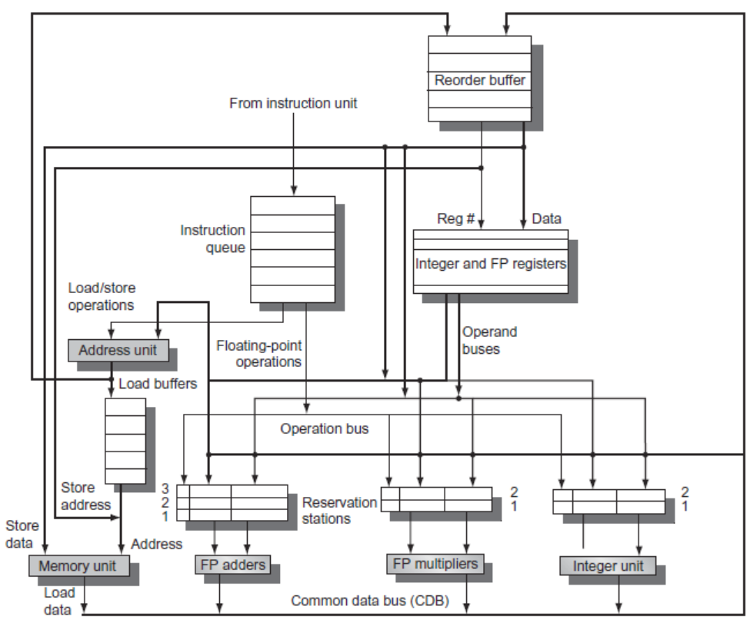
Overview of Design

Slide 10
Multiple Issue
Examine all the dependencies among the instructions in the bundle
If dependencies exist in bundle, encode them in reservation stations
Also need multiple completion/commit
To simplify RS allocation:
Limit the number of instructions of a given class that can be issued in a “bundle”, i.e. on FP, one integer, one load, one store

Slide 11
Example
Loop: ld x2,0(x1) //x2=array element
addi x2,x2,1 //increment x2
sd x2,0(x1) //store result
addi x1,x1,8 //increment pointer
bne x2,x3,Loop //branch if not last

Slide 12
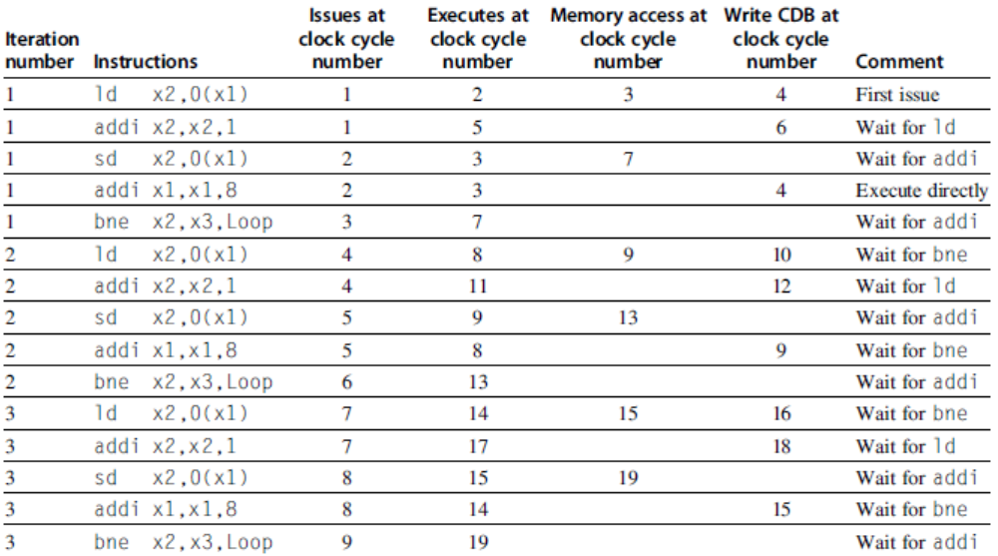
Example (No Speculation)

Slide 13
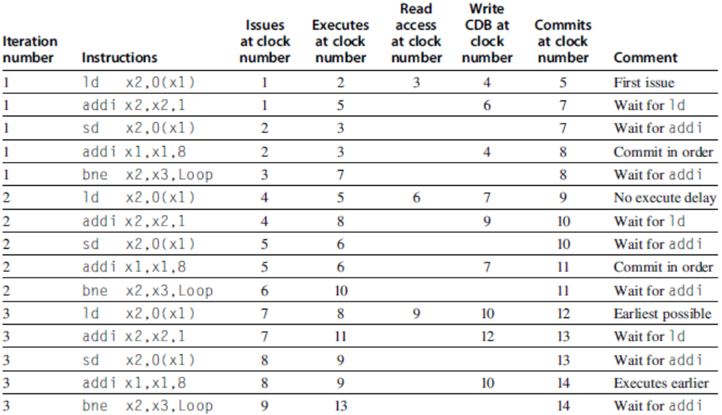
Example (Mutiple Issue with Speculation)

